Slide 2
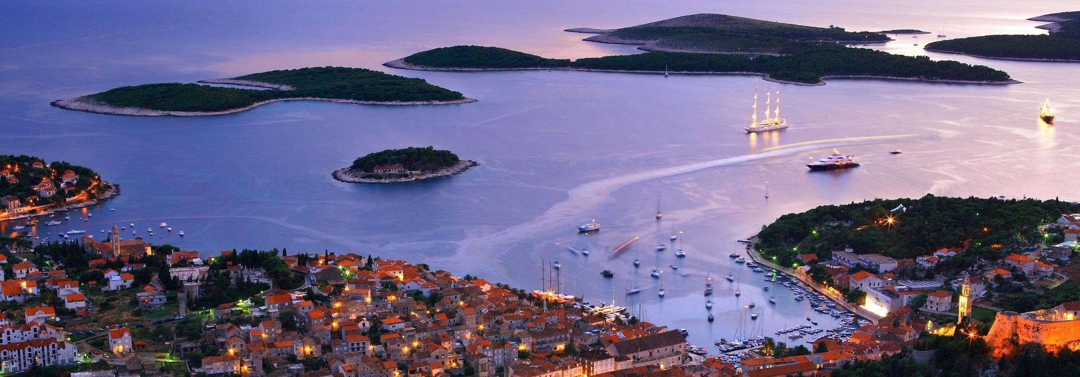
Welcome to Hvar, the island of endless possibilities!

Slide 3
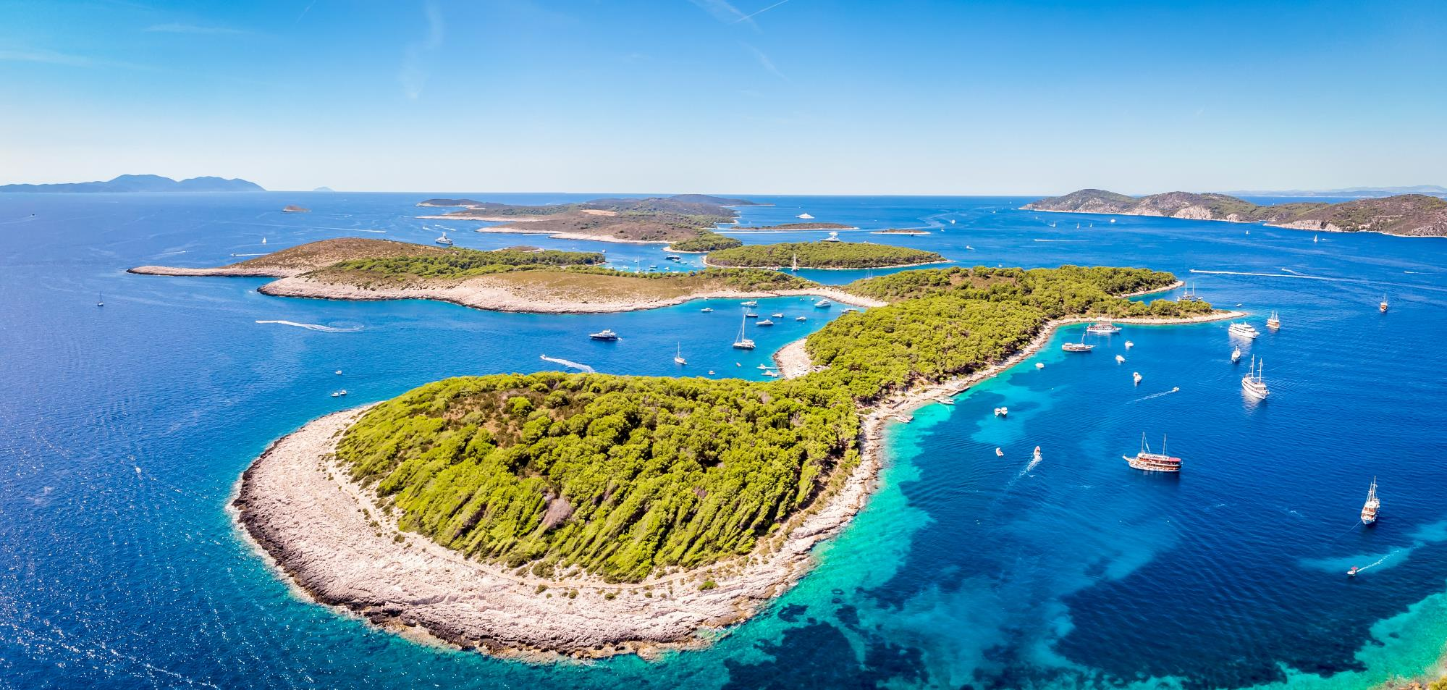
Croatia is the land of 1,000 islands and Hvar is acclaimed as the most prestigious one

Slide 4
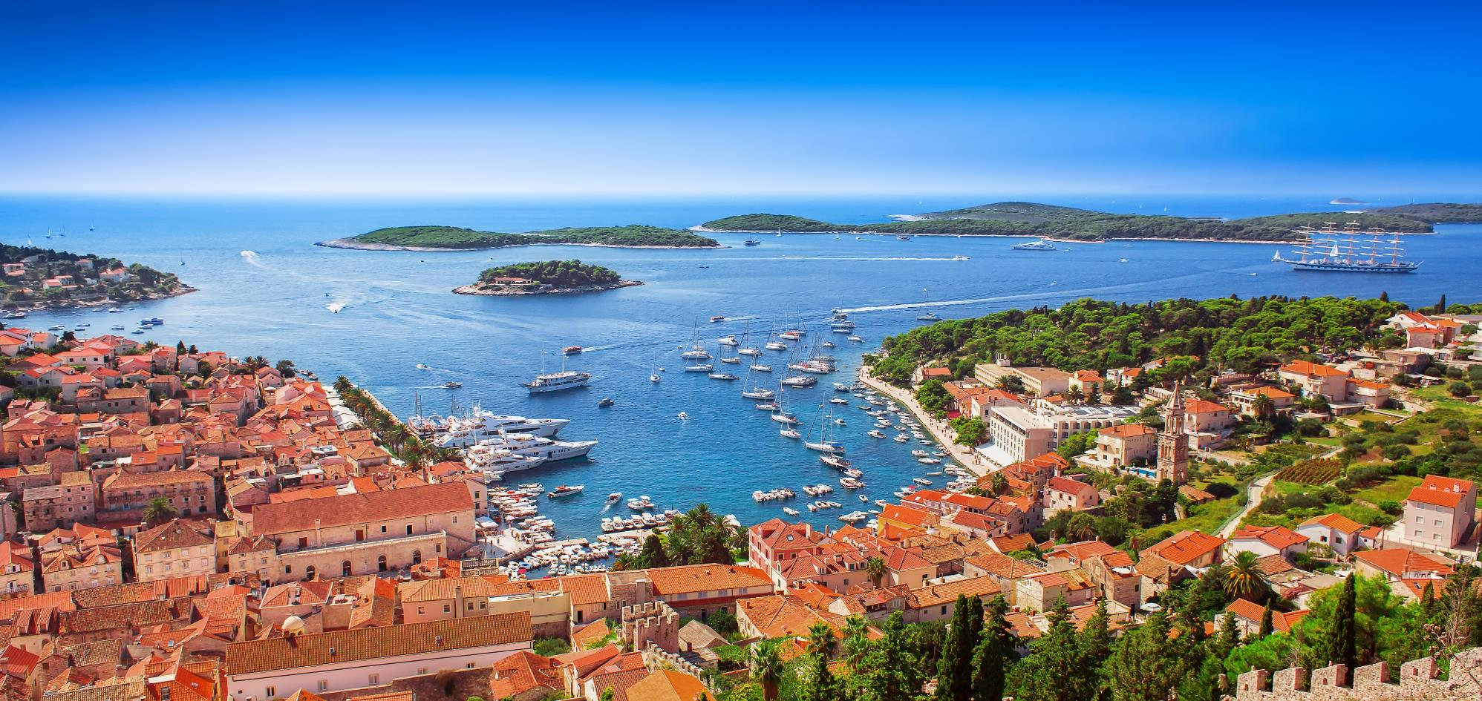
Conde Nast Traveler Readers Choice Awards - HVAR no.1 island in Europe in 2019 and 2021
Travel + Leisure Magazine - HVAR among „The 50 best places to travel in 2023”

Slide 5
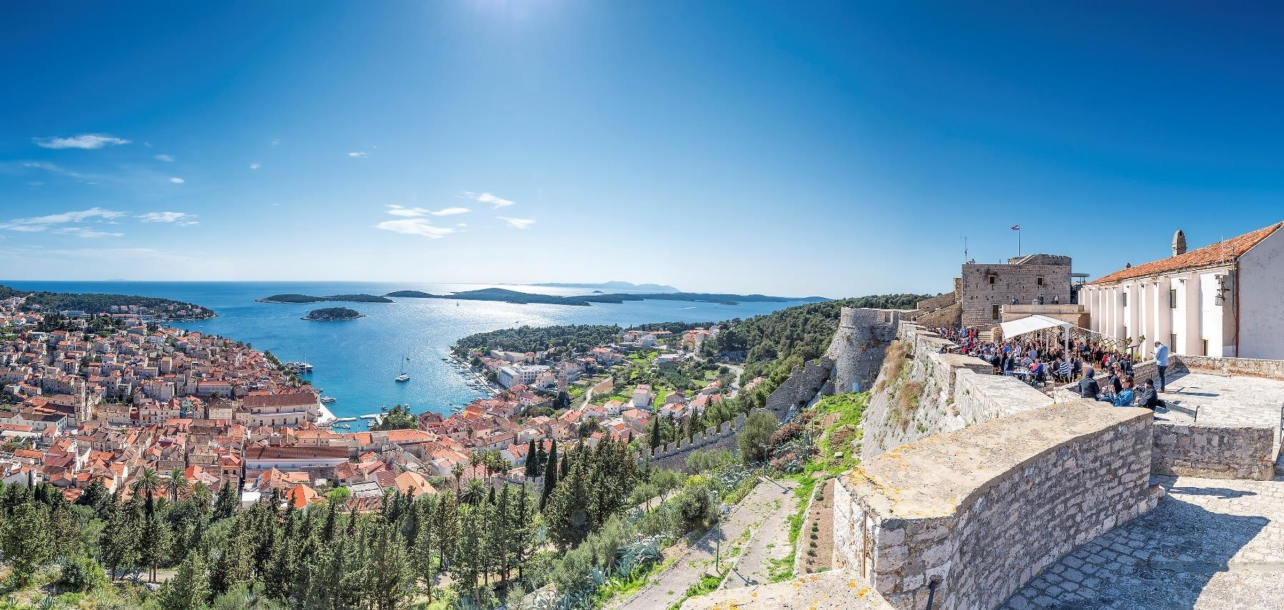
THE ISLAND OF HVAR
is known locally as the St Tropez of Croatia. It is the sunniest island in the Mediterranean with the interior just as stunning as the beaches with peaceful villages, lavender fields, olive groves and wineries. You can reach Hvar by combining your flight with a catamaran or private boat from the airport or Split city harbour. Hvar town harbour is situated right in the heart of Hvar, adorned with Venetian architecture, a typical Mediterranean promenade followed by rocky shoreline and crystal clear waters.

Slide 6
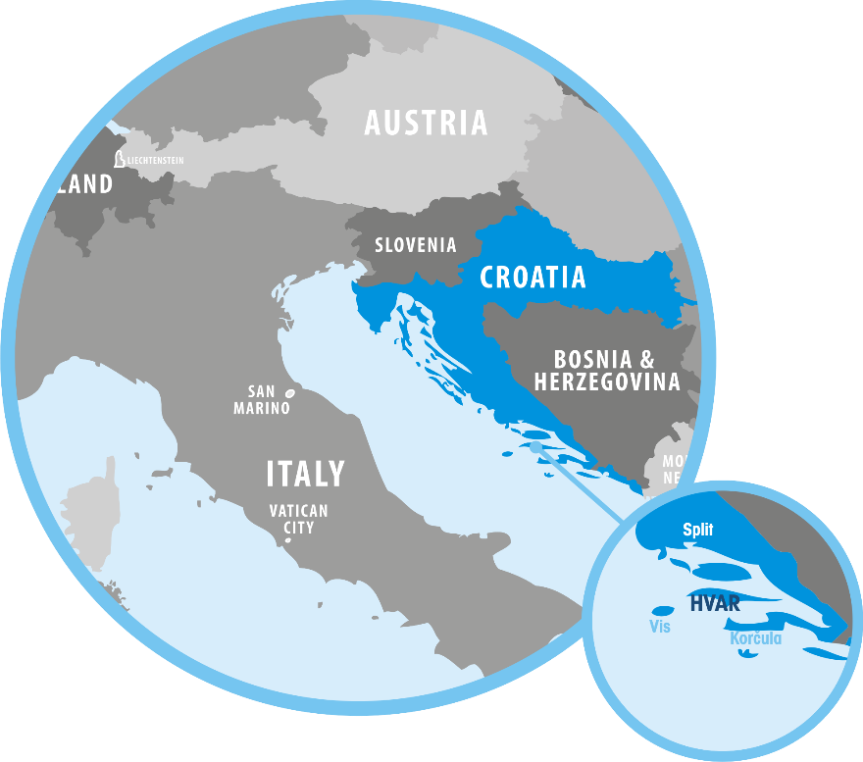
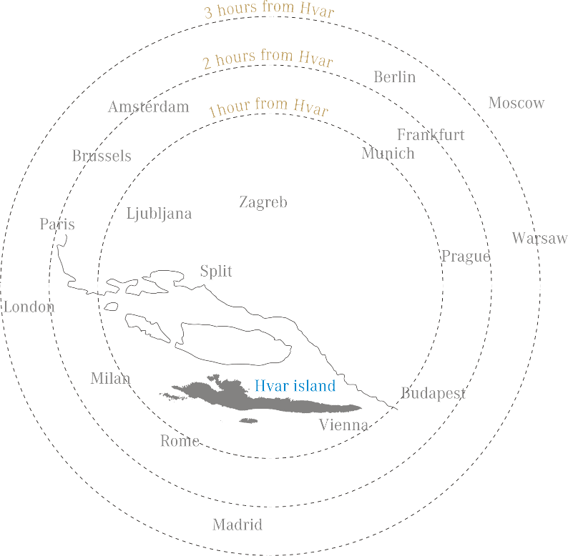

Slide 7
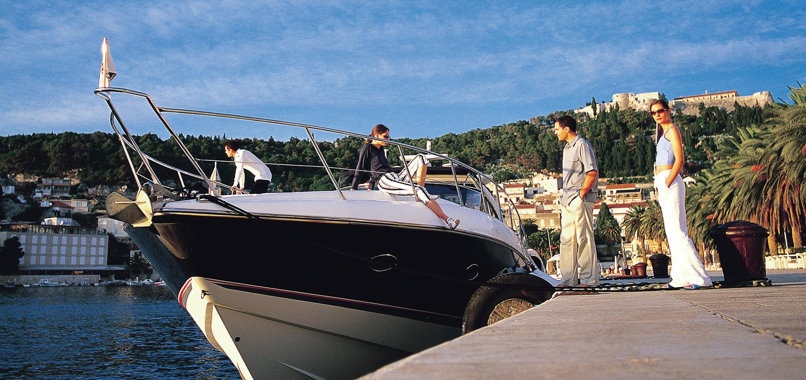
TRANSFER OPTIONS
Hassle free transfer options with private speedboats

Slide 8
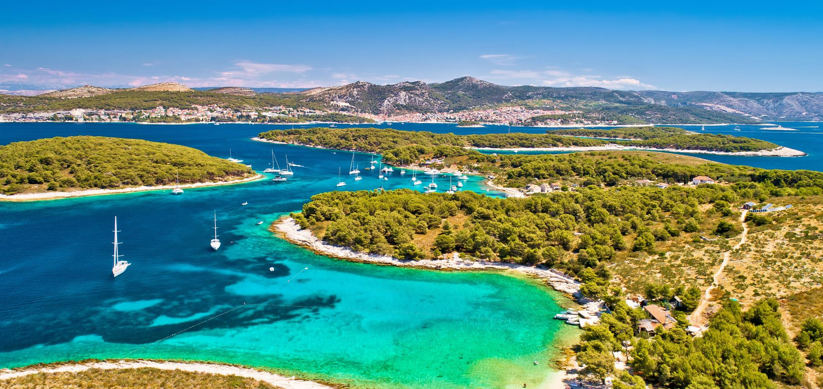
Hvar is renowned for its climate, with 311 days of sun per year is the the sunniest island in the Mediterranean

Slide 9
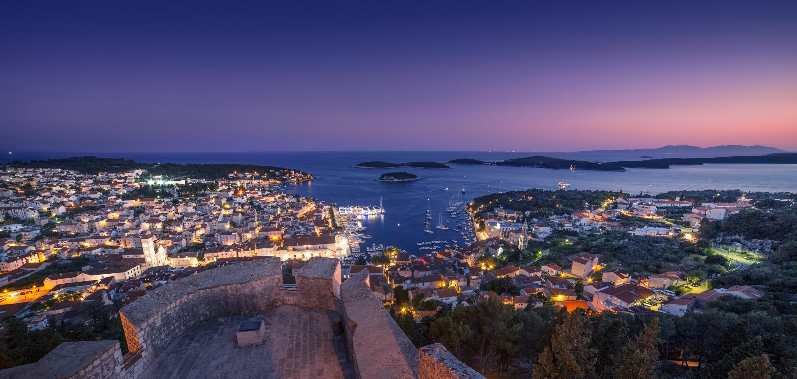
UNESCO ISLAND – 6 tangible and intangible cultural heritages

Slide 10
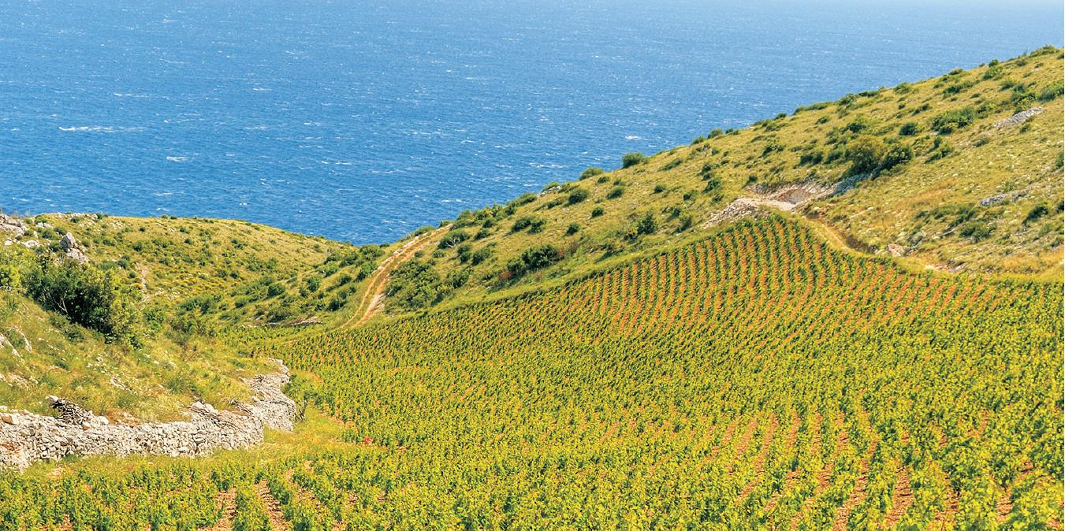
Island of wine for over 2400 years. Some of Croatia’s finest wines are made on the island

Slide 11
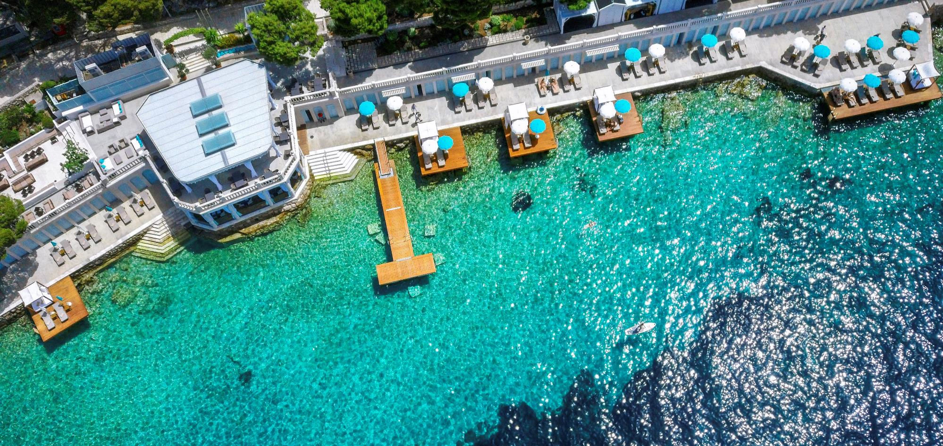
Croatia’s finest beach clubs are located in Hvar
Beach Club Hvar, est 1927

Slide 12
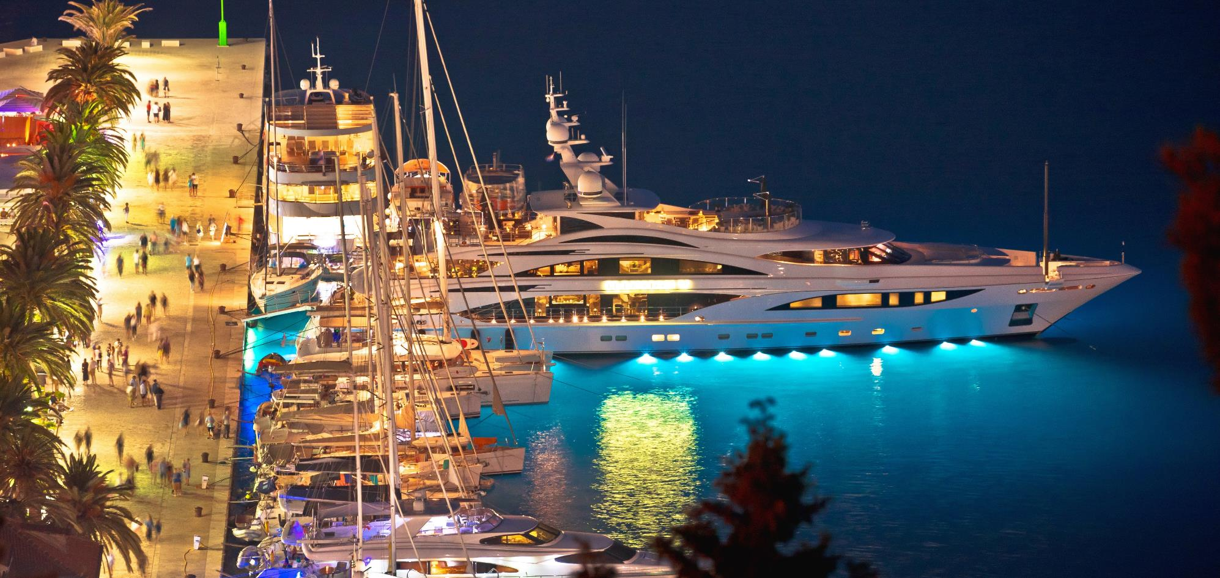
Hvar is famous for it’s vibrant and dynamic nightlife

Slide 13
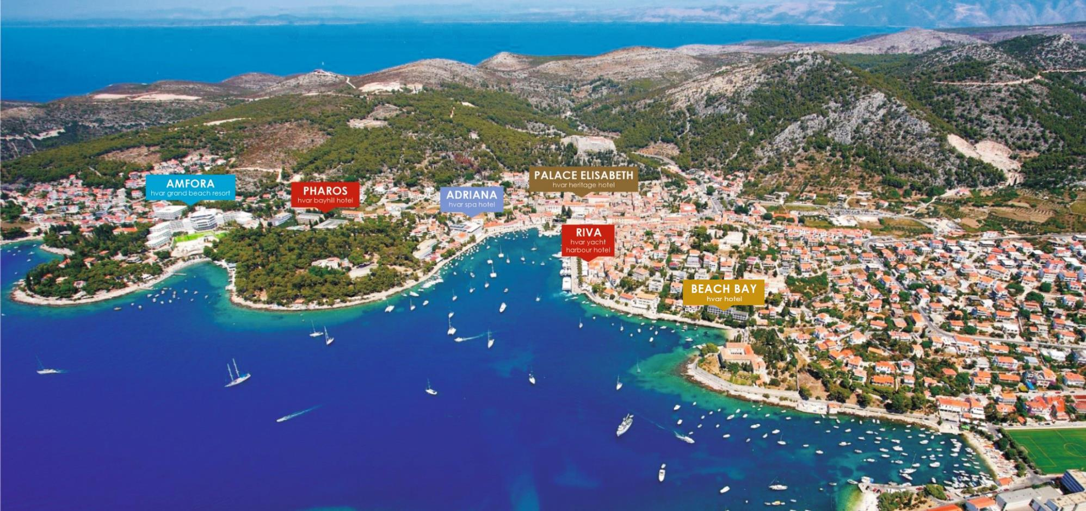

Slide 15
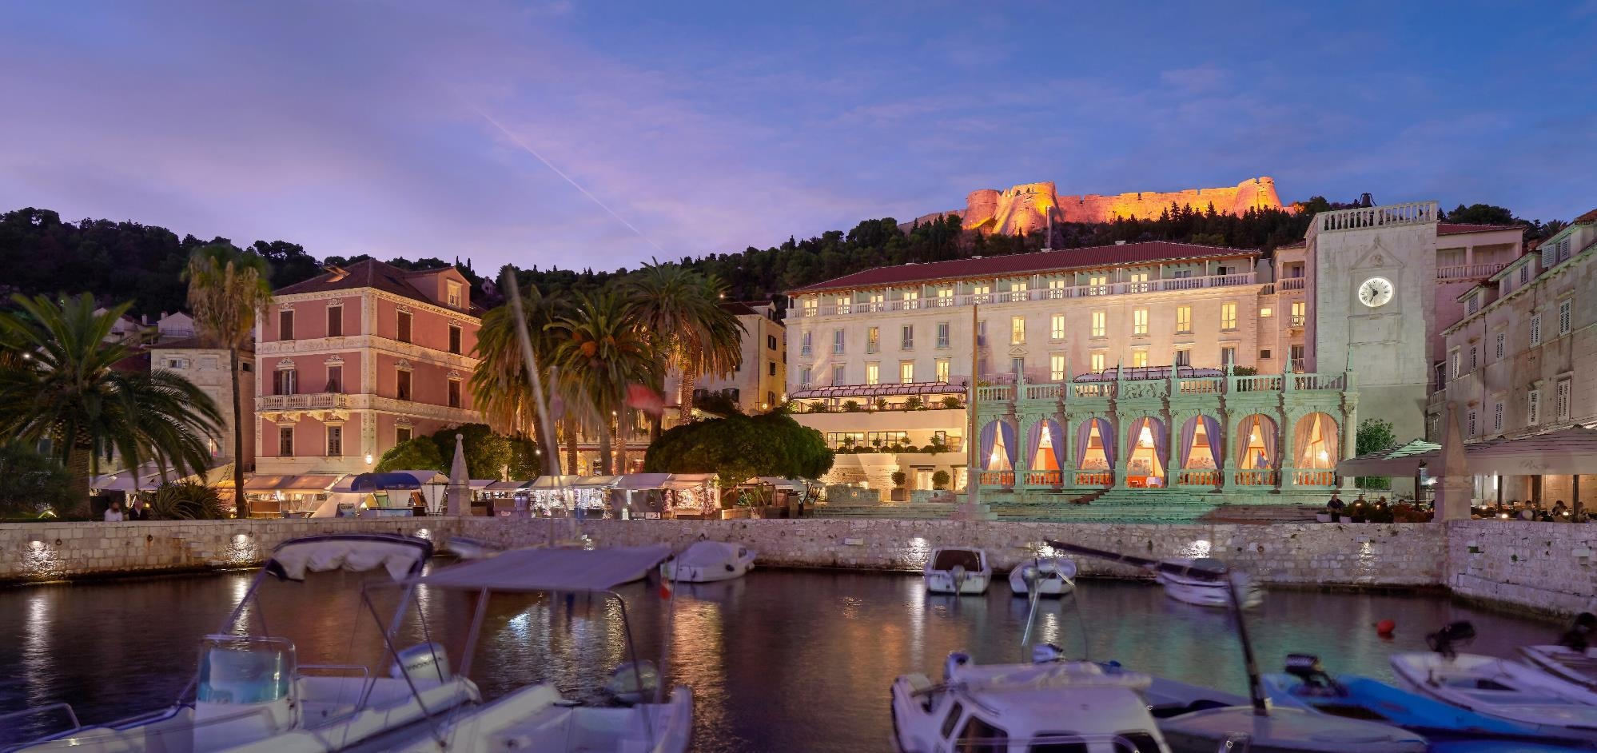
First 5 star hotel in Hvar, member of LHW
Hvar Loggia, Croatia’s most renowned renaissance building

Slide 16
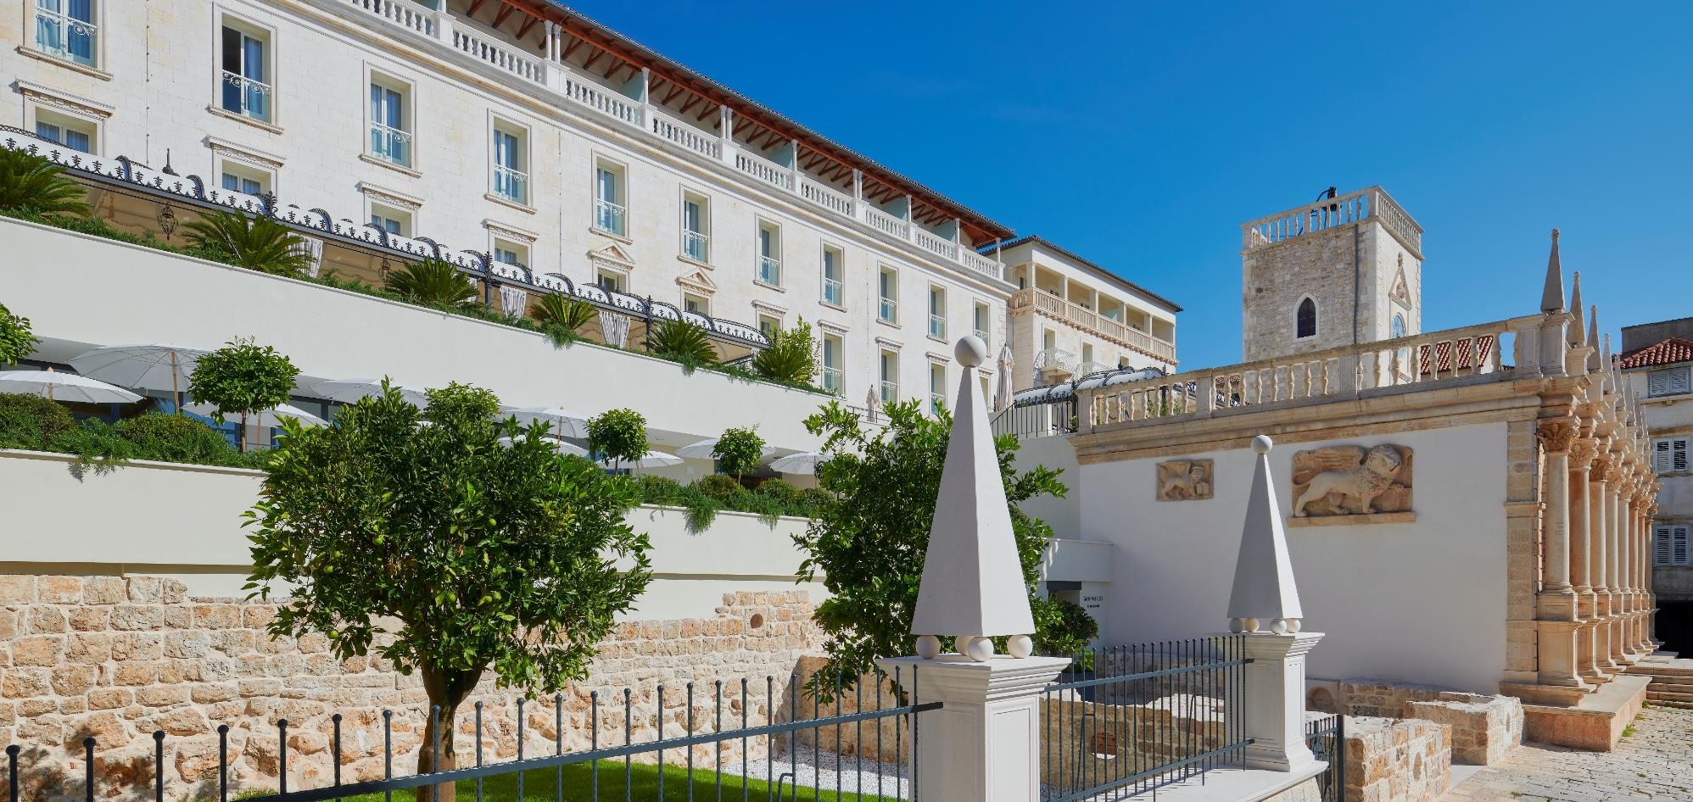
Formerly the Duke’s palace, the history of the hotel dates to the 13th century
It is a landmark building, with a blend of Venetian-Austrian architecture and archeological findings as integral part of the hotel

Slide 17
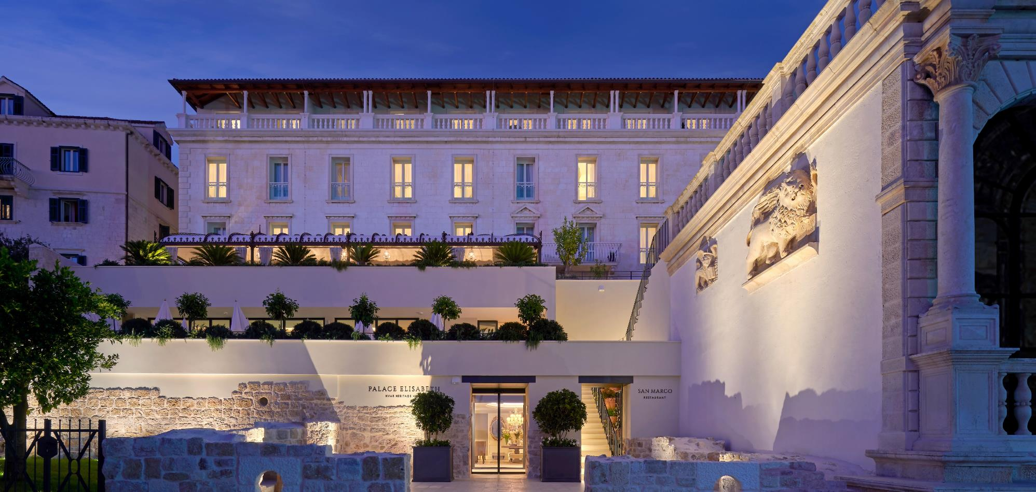
Entrance through Duke’s court embellished with indigenous plants and centuries old archeological findings

Slide 18
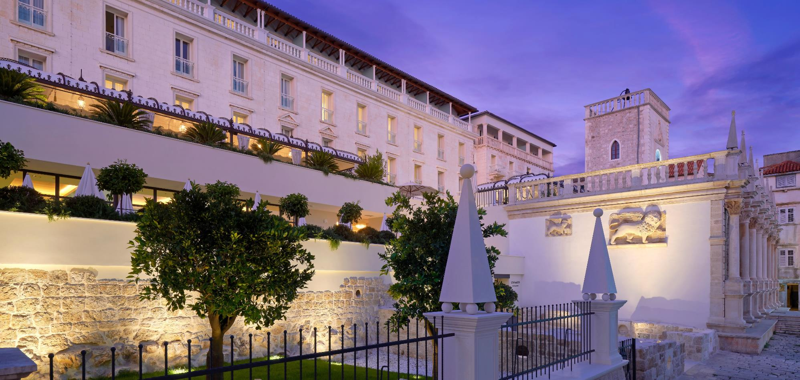
In 1902 hotel opened as Spa Hotel Empress Elisabeth,
after the famous Austrian Empress Sisi

Slide 19
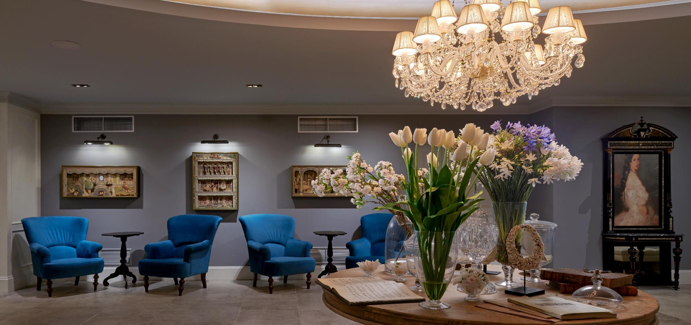
In 2019 the hotel was completely renovated and in respect to hotel's history it bears her name - Palace Elisabeth, hvar heritage hotel

Slide 20
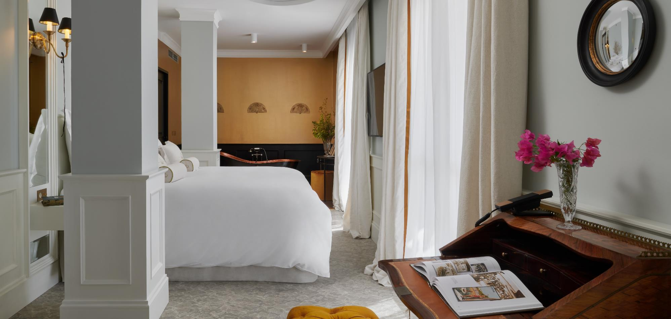
44 ROOMS & SUITES
All rooms are unique and characterized by an elegant design with hand-painted murals of Hvar motives.

Slide 21
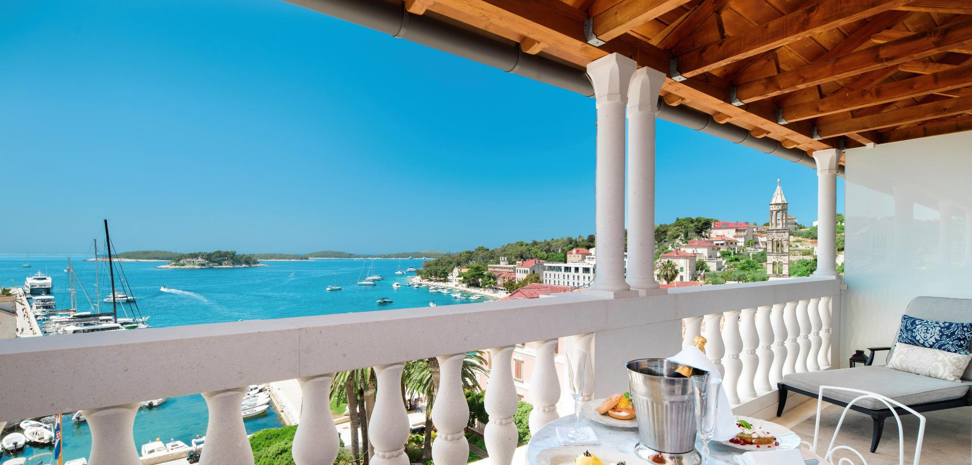
Uninterrupted sea views overlooking Hvar port from multiple Venetian terraces

Slide 22
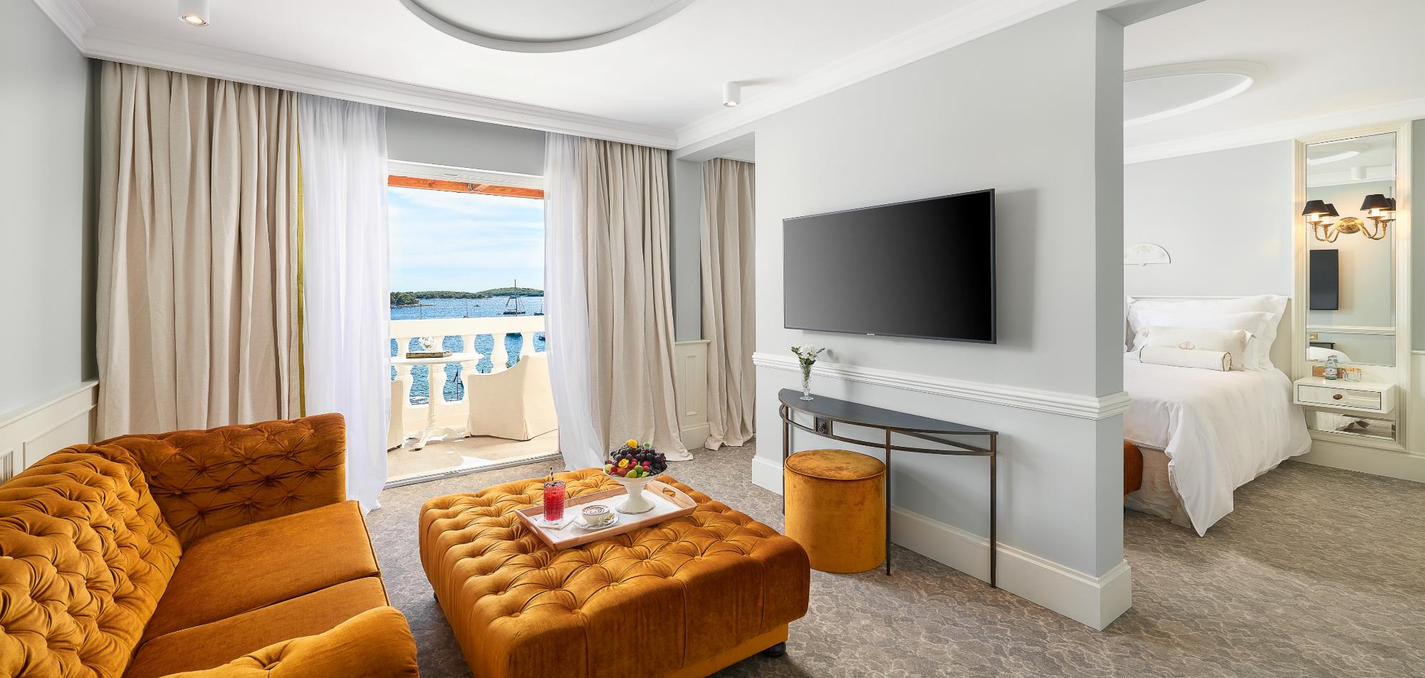
SIGNATURE SUITES
Penthouse Suites, Balcony, Sea View (48 - 53 sqm, 3 units)
Imperial Suite, Balcony, Sea View (57 sqm, 1 unit)
Elisabeth Suite, Balcony, Sea view (61 sqm, 1 unit)

Slide 23
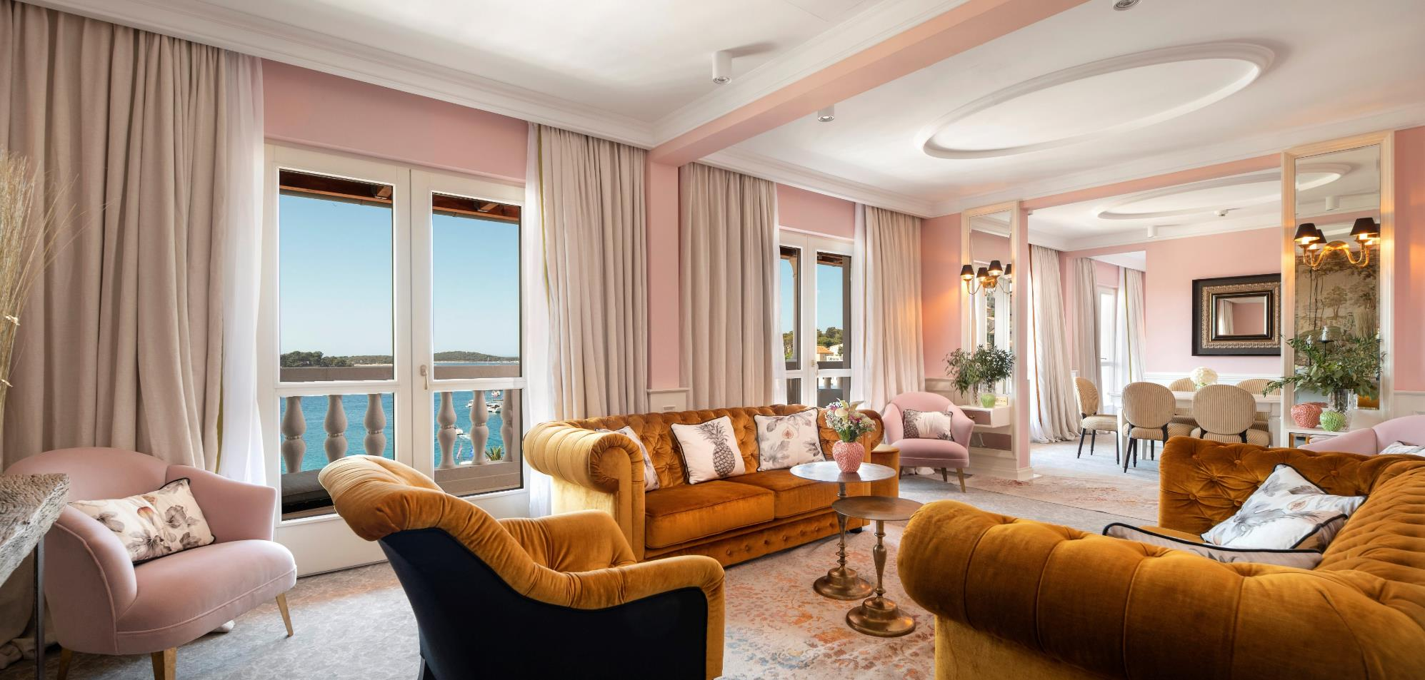
Presidential Penthouse suite, balcony sea view (90 sqm, 1 unit)
Hvar’s most exclusive suite.

Slide 24
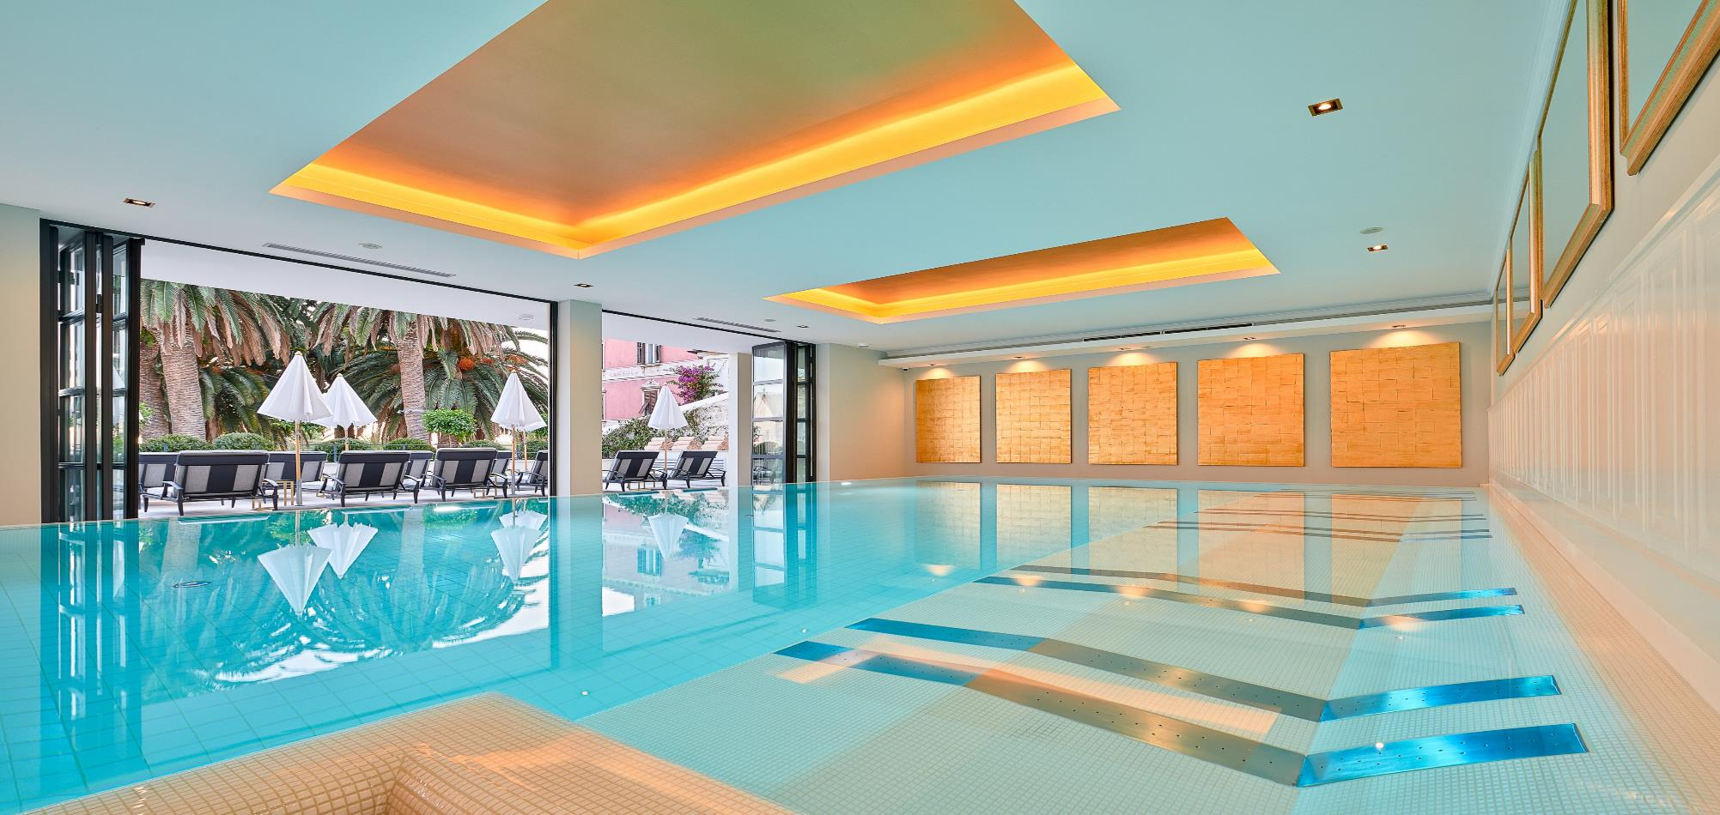
SPA
The Spa features luxurious spaces and VIP areas
Services offered are centered on relaxing, rejuvenating and restoring principles

Slide 25
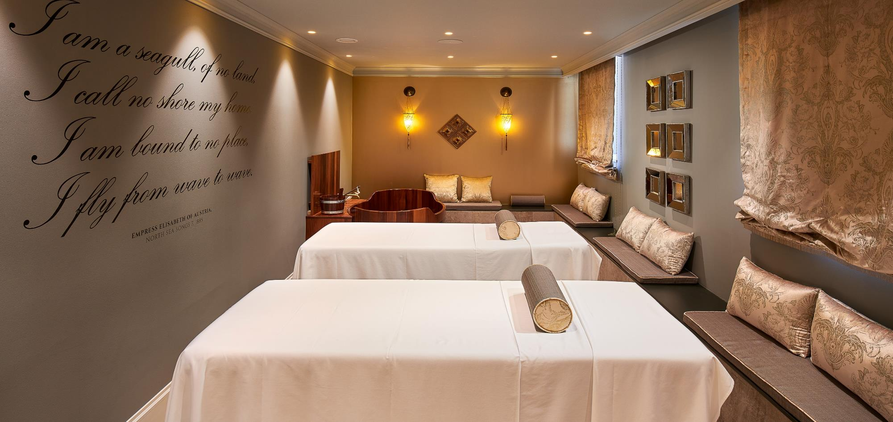
VIP Treatment Suite is available for experience created and designed according to individual needs

Slide 26
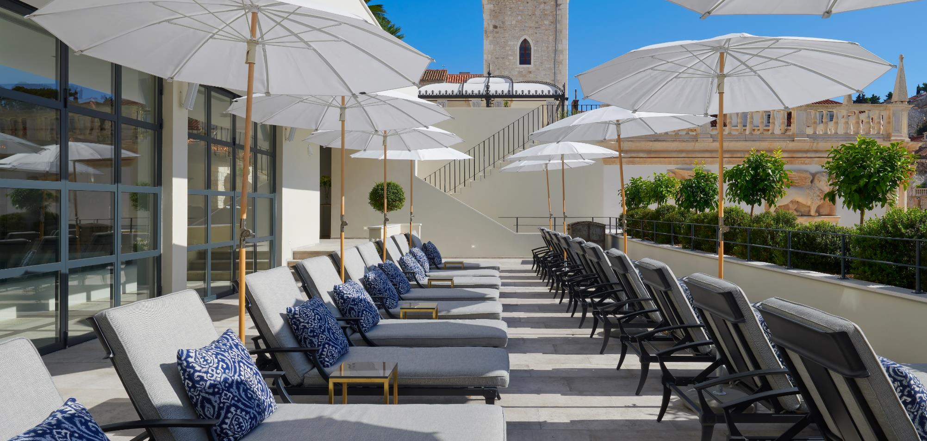

Slide 27
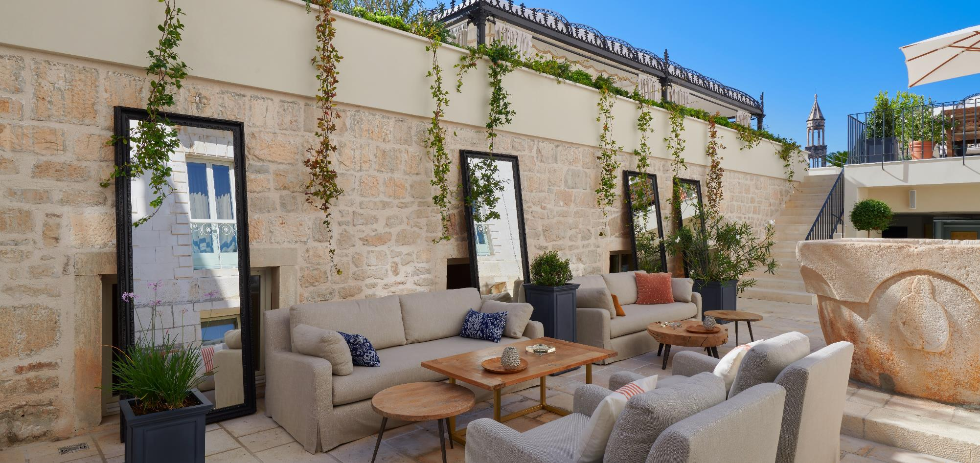

Slide 28
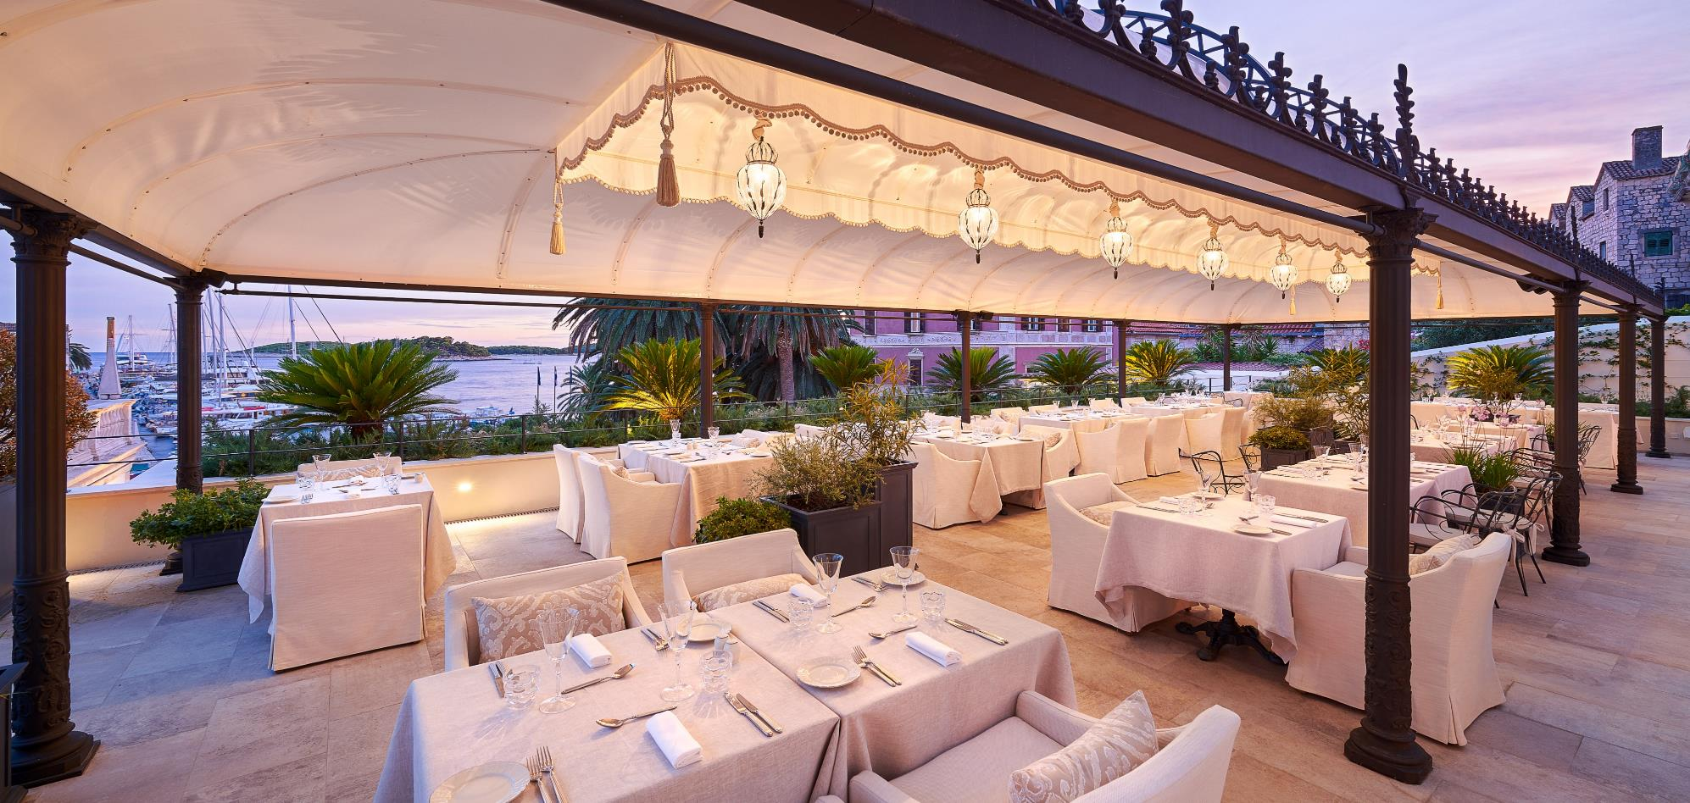
SAN MARCO RESTAURANT
Overlooking the main town square, San Marco provides a haven for those who want to enjoy delectable dishes with uninterrupted sea views.

Slide 29
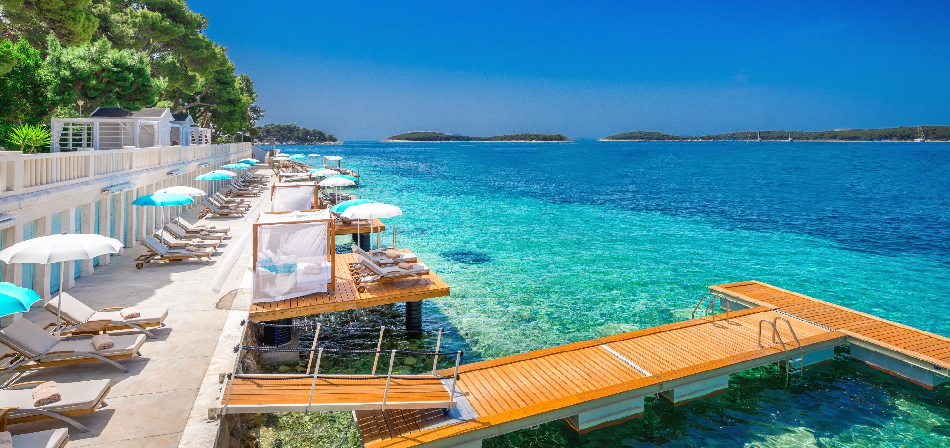

Slide 30
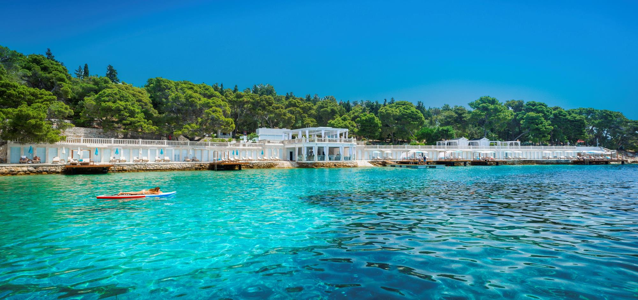
Established in 1927
A synonym for unsurpassed beach time
Beach Club Hvar

Slide 31
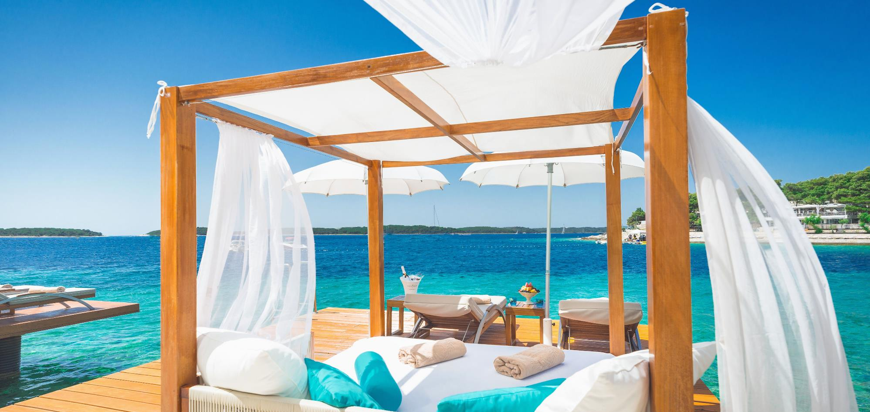
Quintessenatial Hvar
Beach Club Hvar

Slide 32
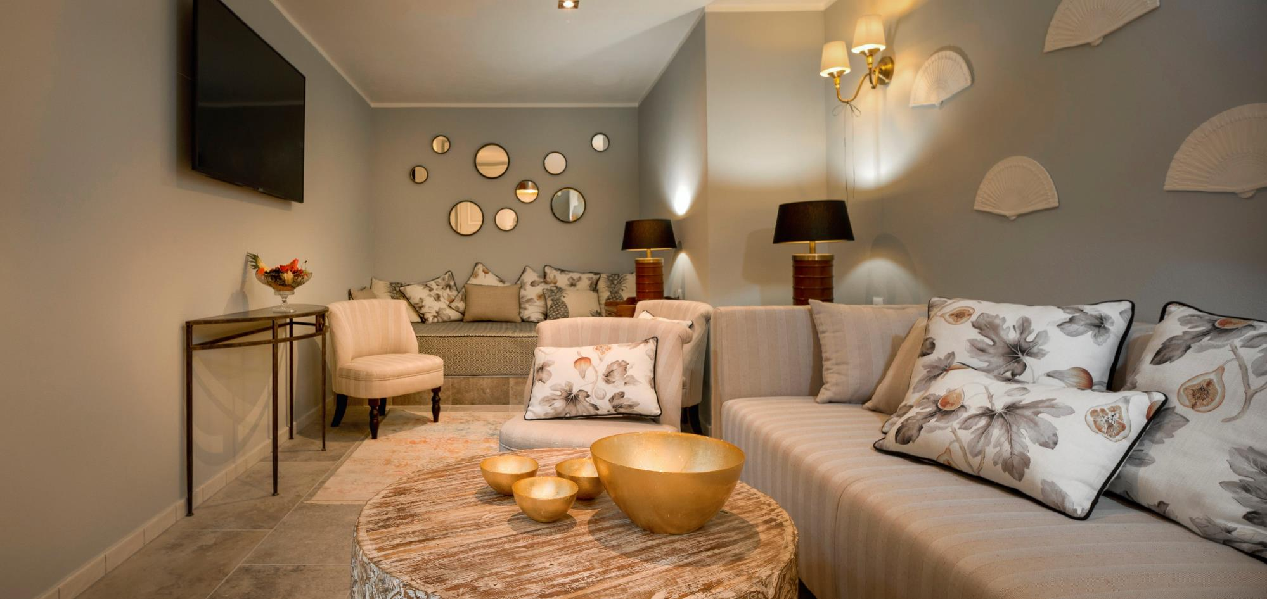
Grand Beach Suite
Air-conditioned relaxation quarters, pontoons, sunbeds or baldachin beds

Slide 34
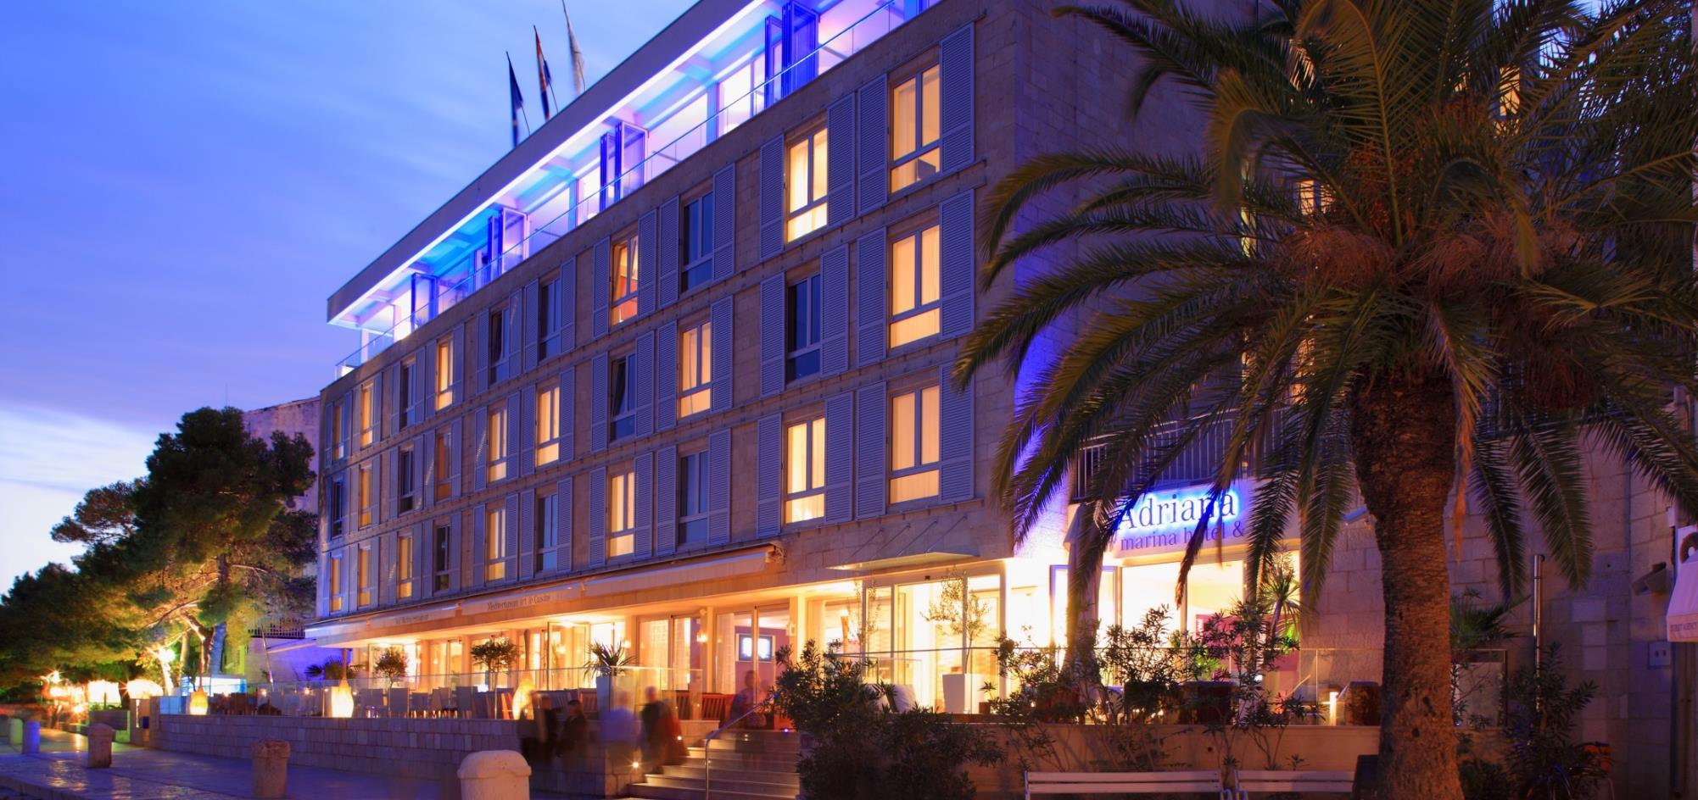

Slide 35
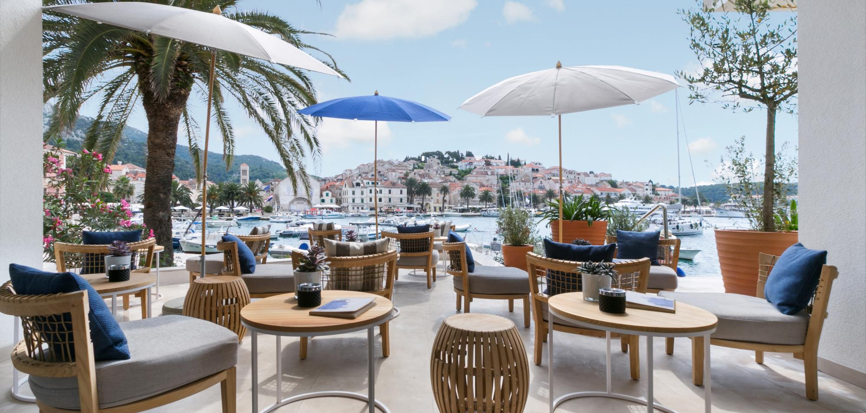

Slide 36
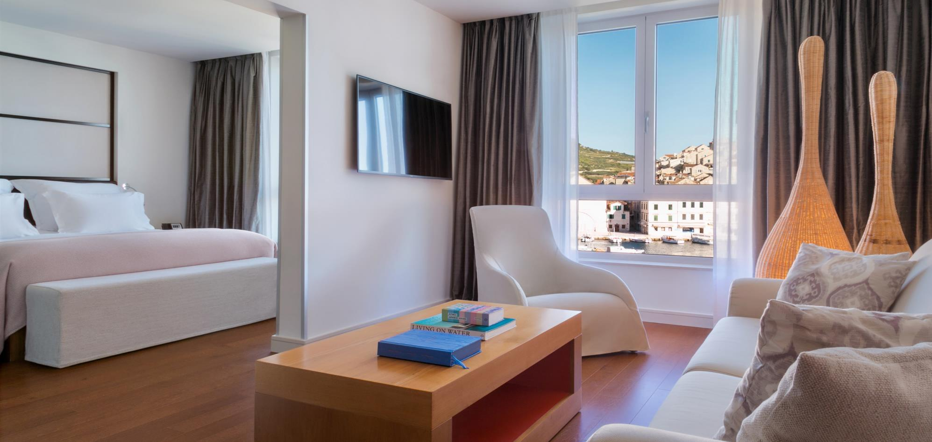
62 ROOMS & SUITES

Slide 37
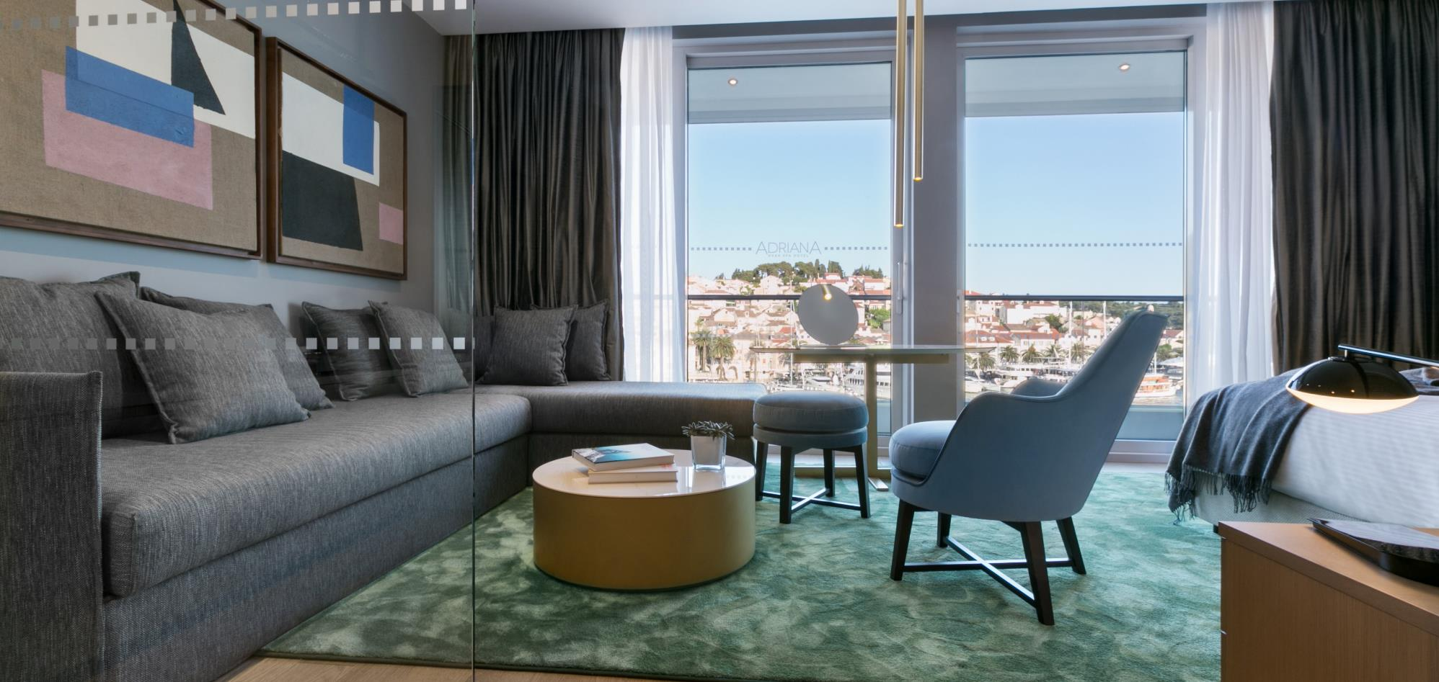
Penthouse suite, 3 units

Slide 38
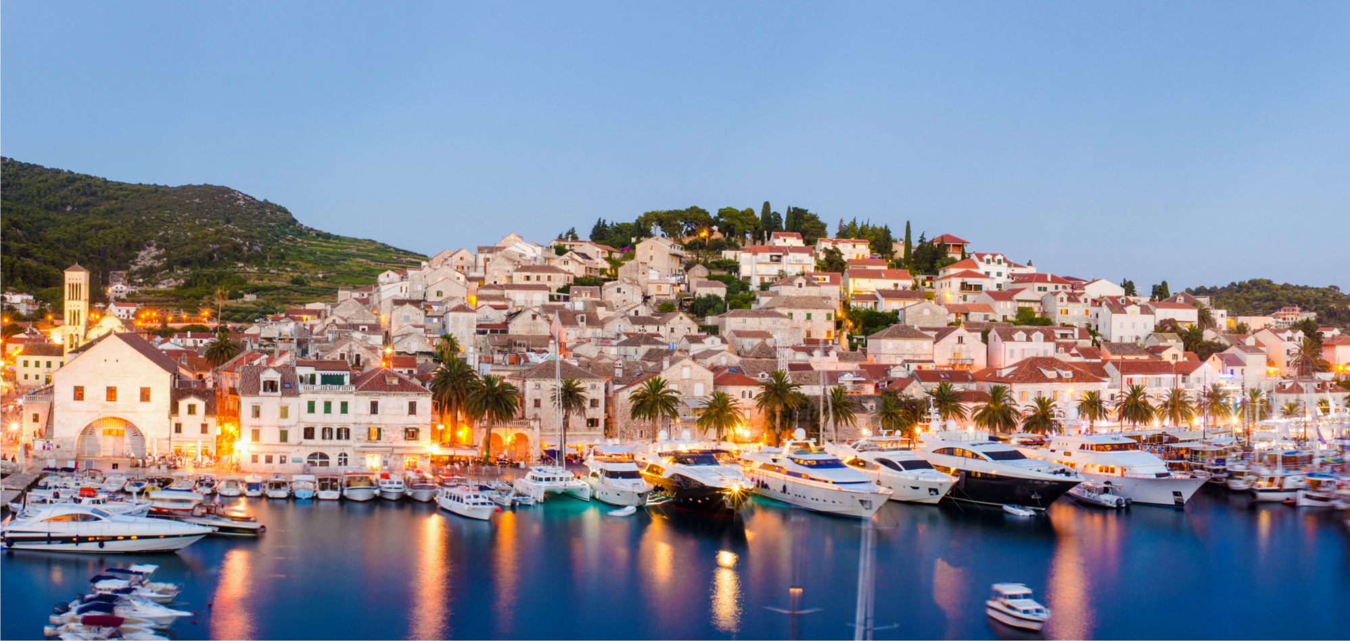
STUNNING VIEWS
of the city and the marina

Slide 39
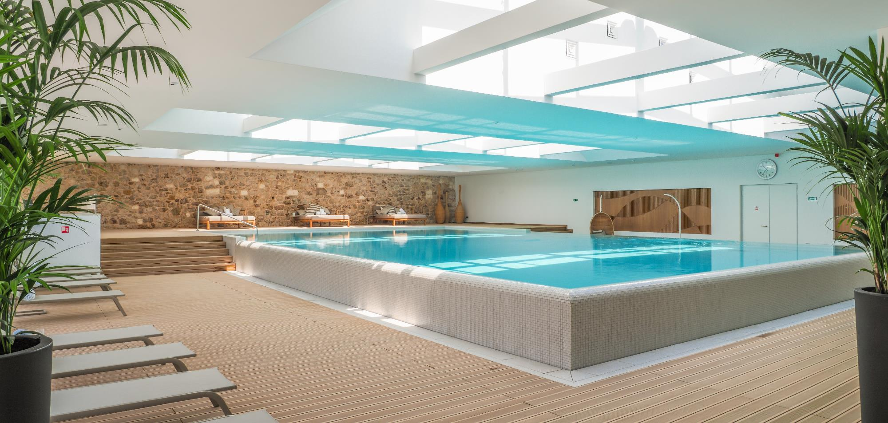
Hvar’s premier spa hotel with 1600 sqm of spa facilities, rooftop pool

Slide 40
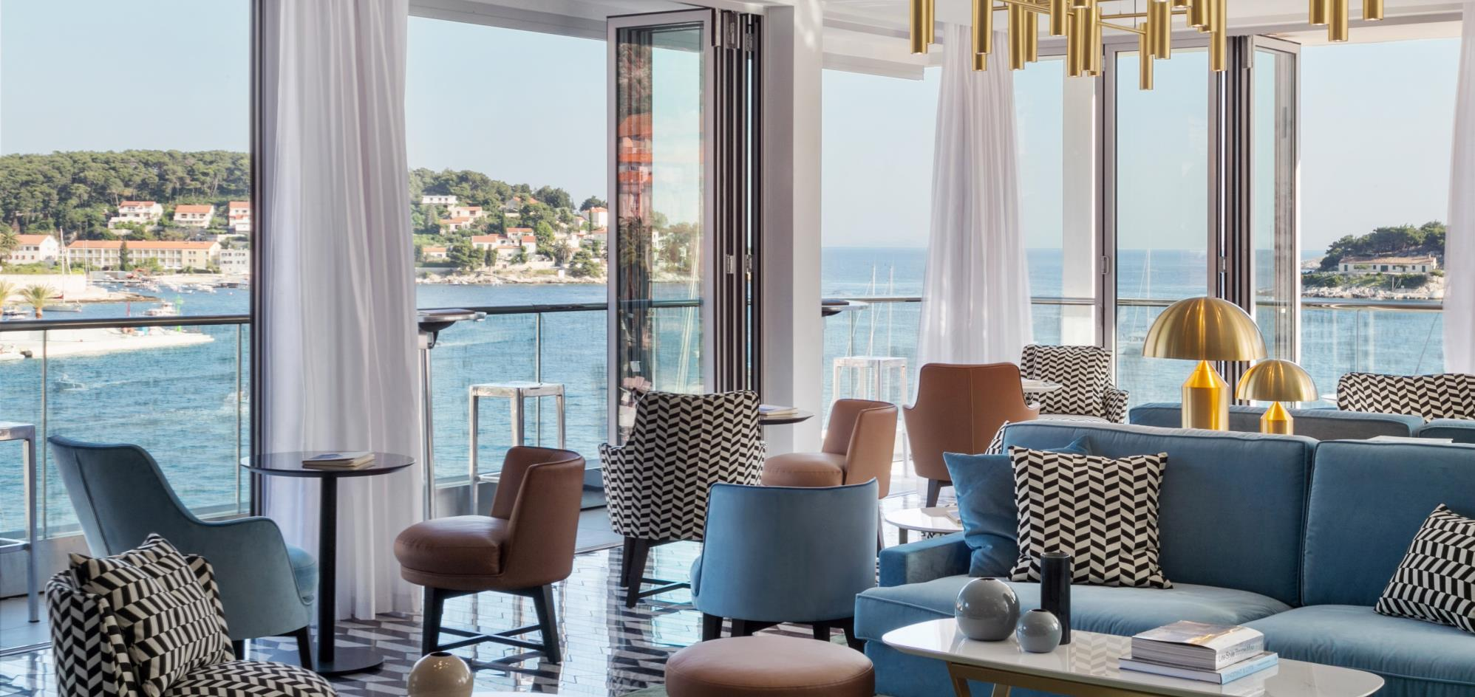
THE TOP BAR

Slide 41
Hvar’s premier spa hotel with 1600 sqm of spa facilities, rooftop pool

Slide 42
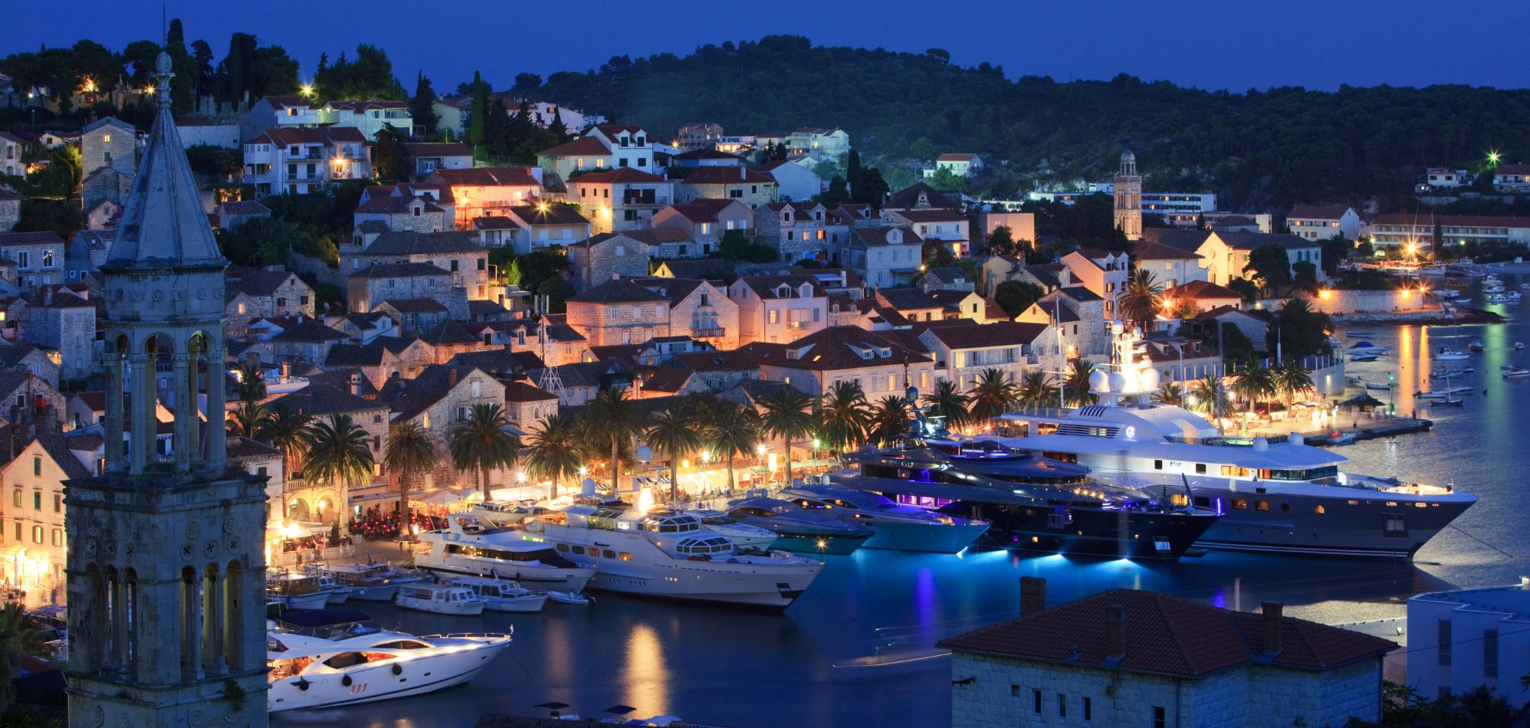
Delightfully located on the waterfront promenade
Hvar’s premier spa hotel with 1600 sqm of spa facilities, rooftop pool

Slide 43
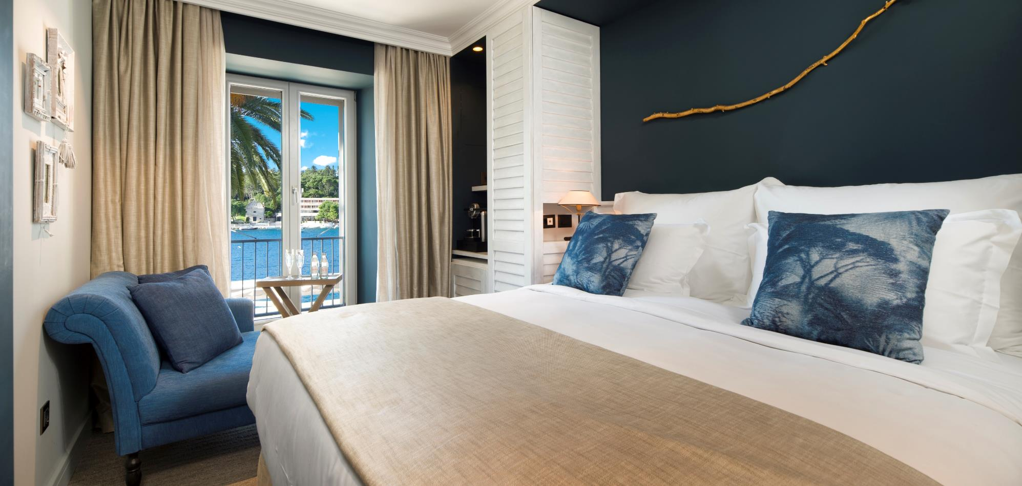
Newly renovated in 2022
Hvar’s premier spa hotel with 1600 sqm of spa facilities, rooftop pool

Slide 44
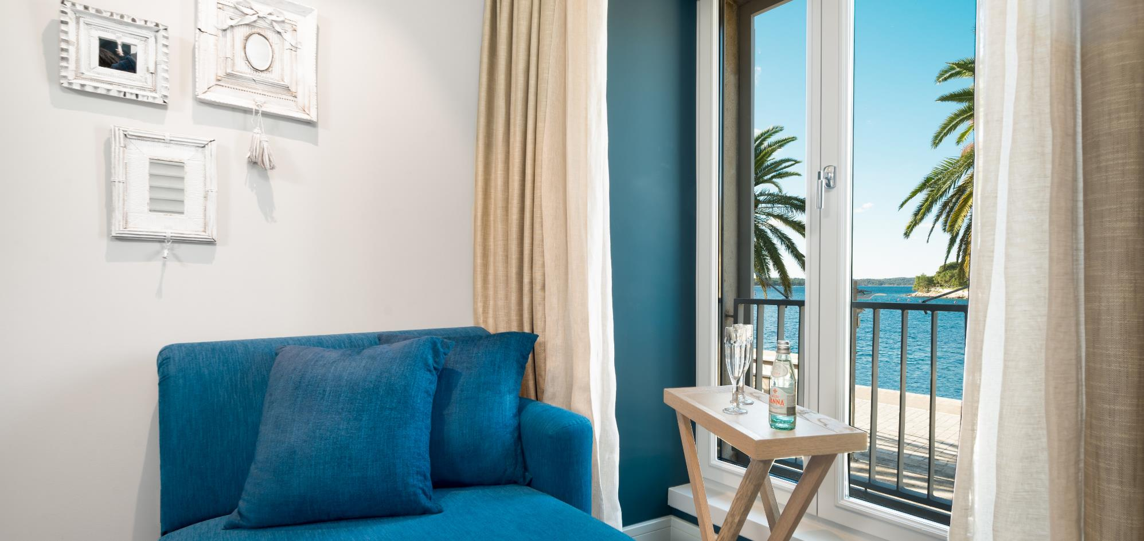
Hvar’s premier spa hotel with 1600 sqm of spa facilities, rooftop pool
50 ROOMS & SUITES

Slide 45
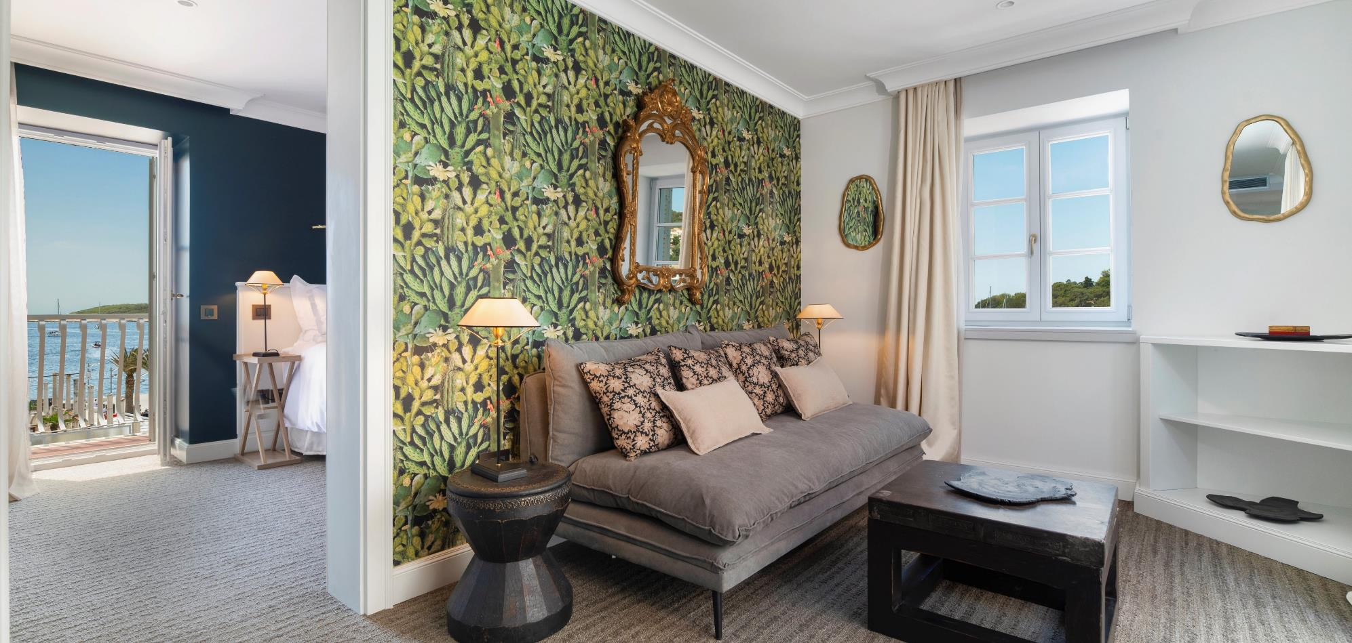
Hvar’s premier spa hotel with 1600 sqm of spa facilities, rooftop pool
Each room uniquely designed with antique details and artefacts

Slide 46
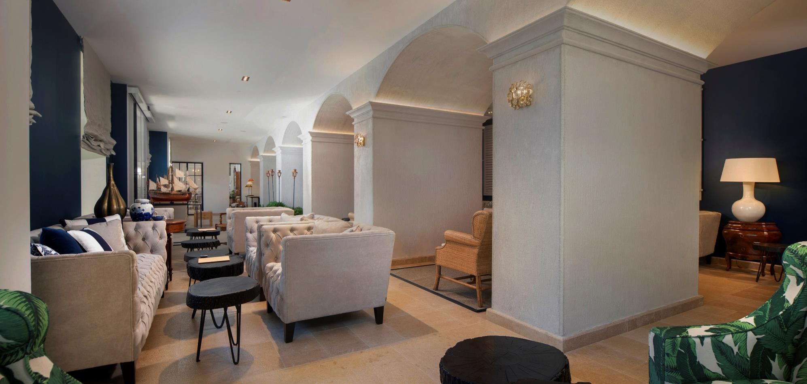
Hvar’s premier spa hotel with 1600 sqm of spa facilities, rooftop pool

Slide 47
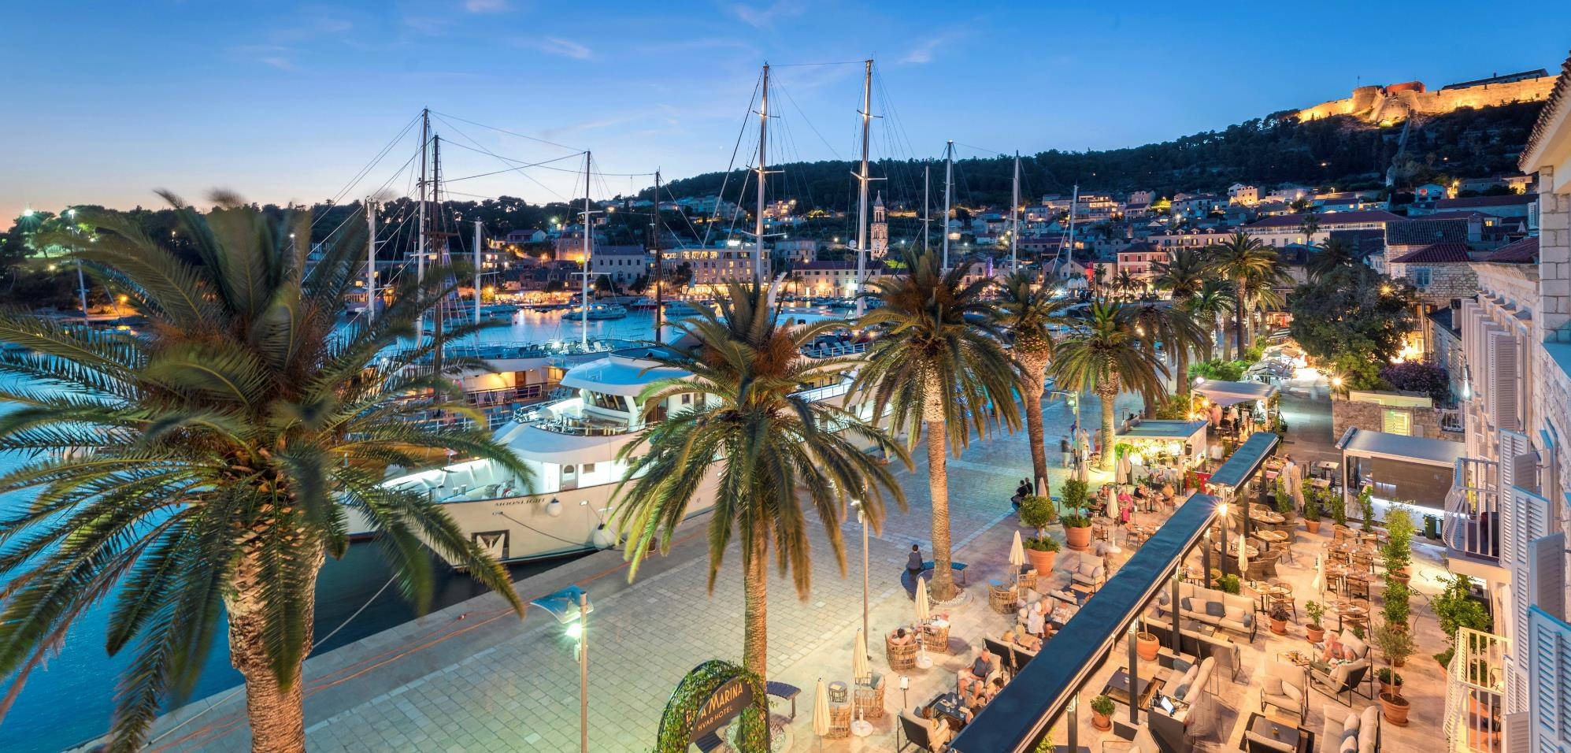
BB CLUB TERRACE
Hvar’s premier spa hotel with 1600 sqm of spa facilities, rooftop pool

Slide 48
Hvar’s premier spa hotel with 1600 sqm of spa facilities, rooftop pool

Slide 49
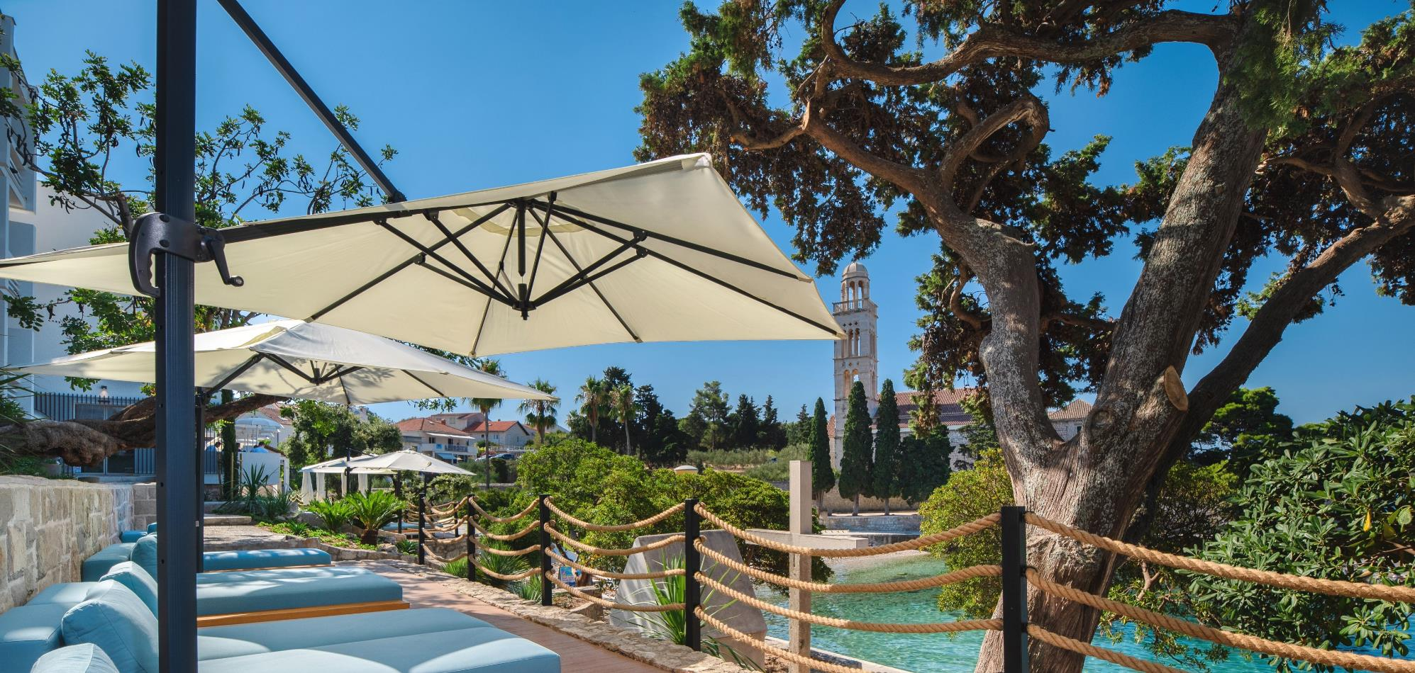
SUSTAINABLE TRAVEL PLEDGE:
Locally sourced products
Energy efficient equipment (own solar power system)
Digitalization: self-check possible, digital concierge service
MINIMIZING SINGLE-USE PLASTIC - usage of natural materials that are easily recycled

Slide 50
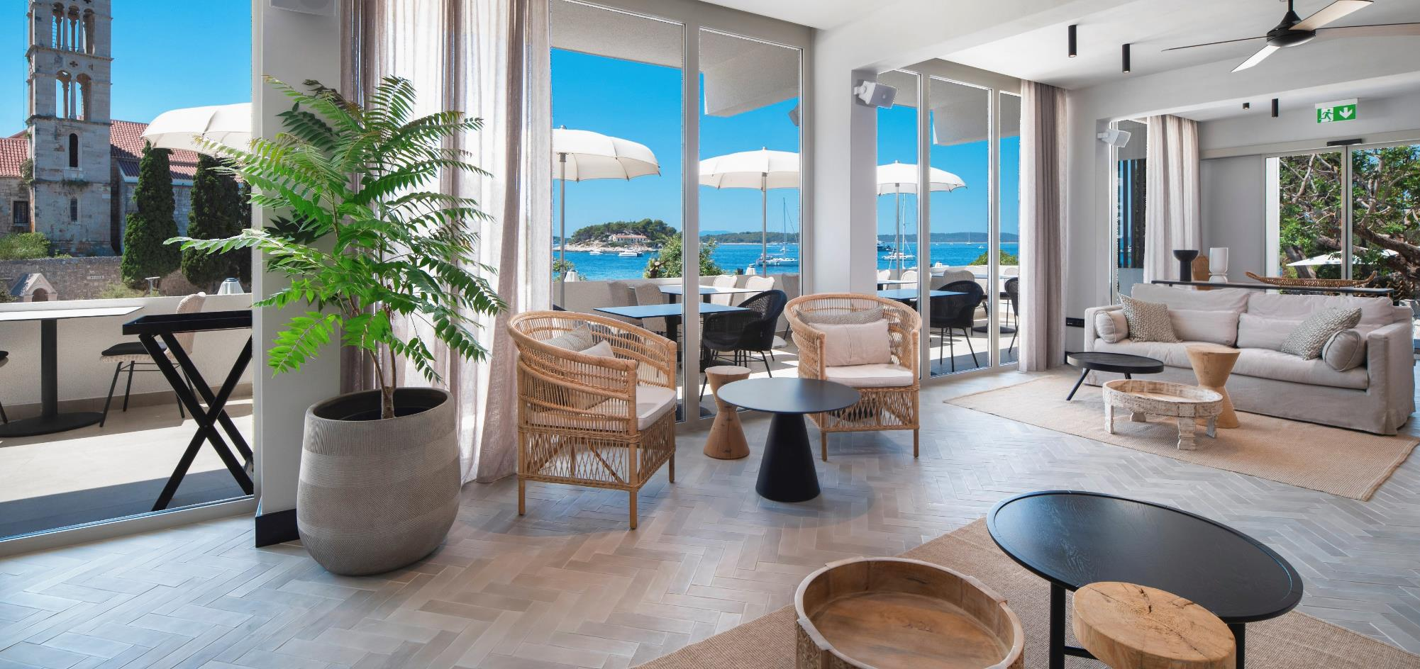
Hvar’s premier spa hotel with 1600 sqm of spa facilities, rooftop pool

Slide 51
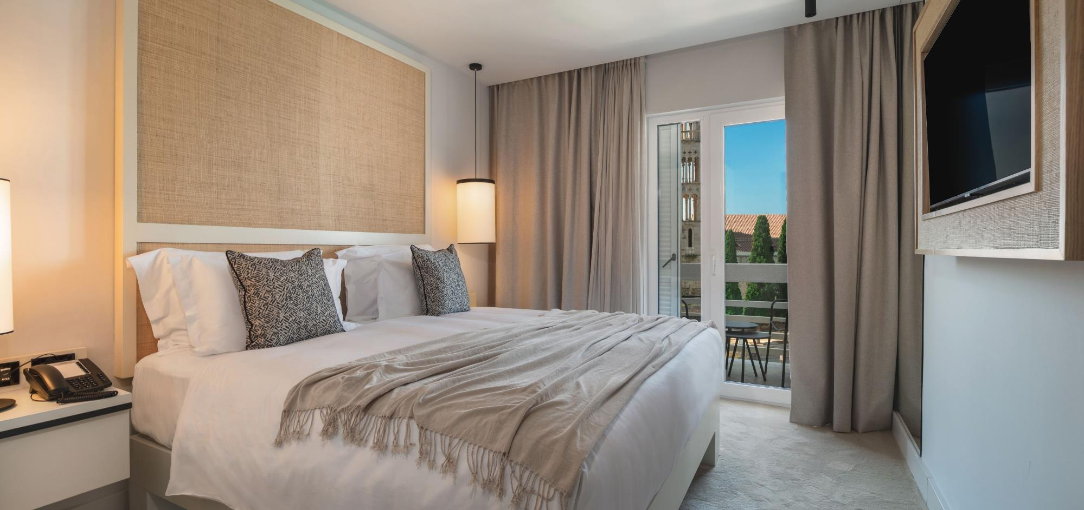
33 ROOMS & SUITES
All rooms with balcony and sea views designed using recycled materials
Hvar’s premier spa hotel with 1600 sqm of spa facilities, rooftop pool

Slide 52
Hvar’s premier spa hotel with 1600 sqm of spa facilities, rooftop pool

Slide 53
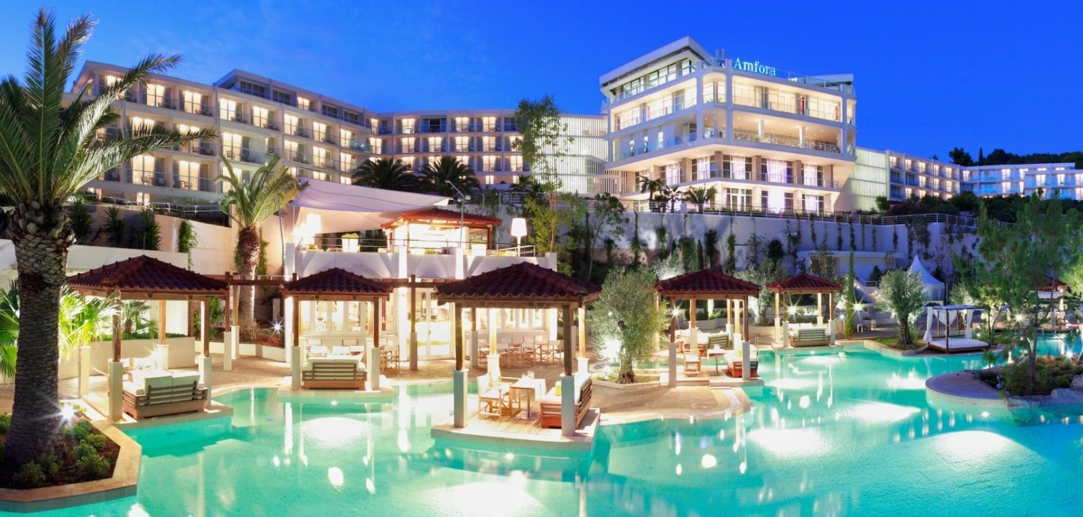
Hvar’s premier spa hotel with 1600 sqm of spa facilities, rooftop pool

Slide 54
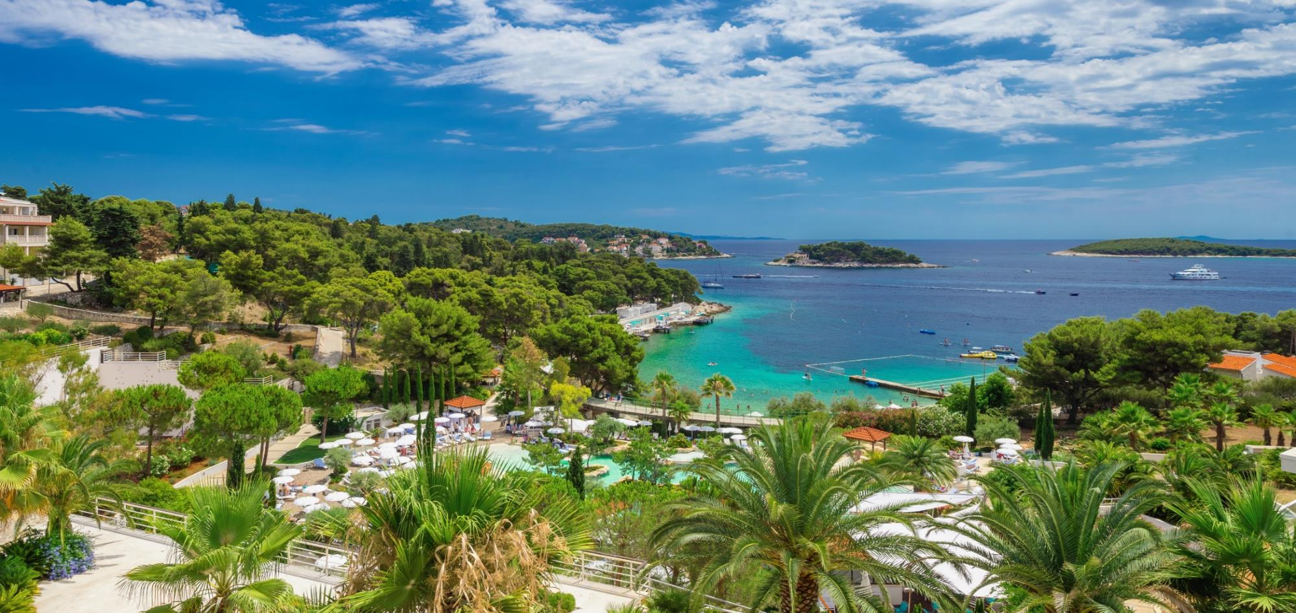
Located in a tranquil bay
330 rooms, cascading pool, meeting rooms with daylight
Hvar’s premier spa hotel with 1600 sqm of spa facilities, rooftop pool

Slide 55
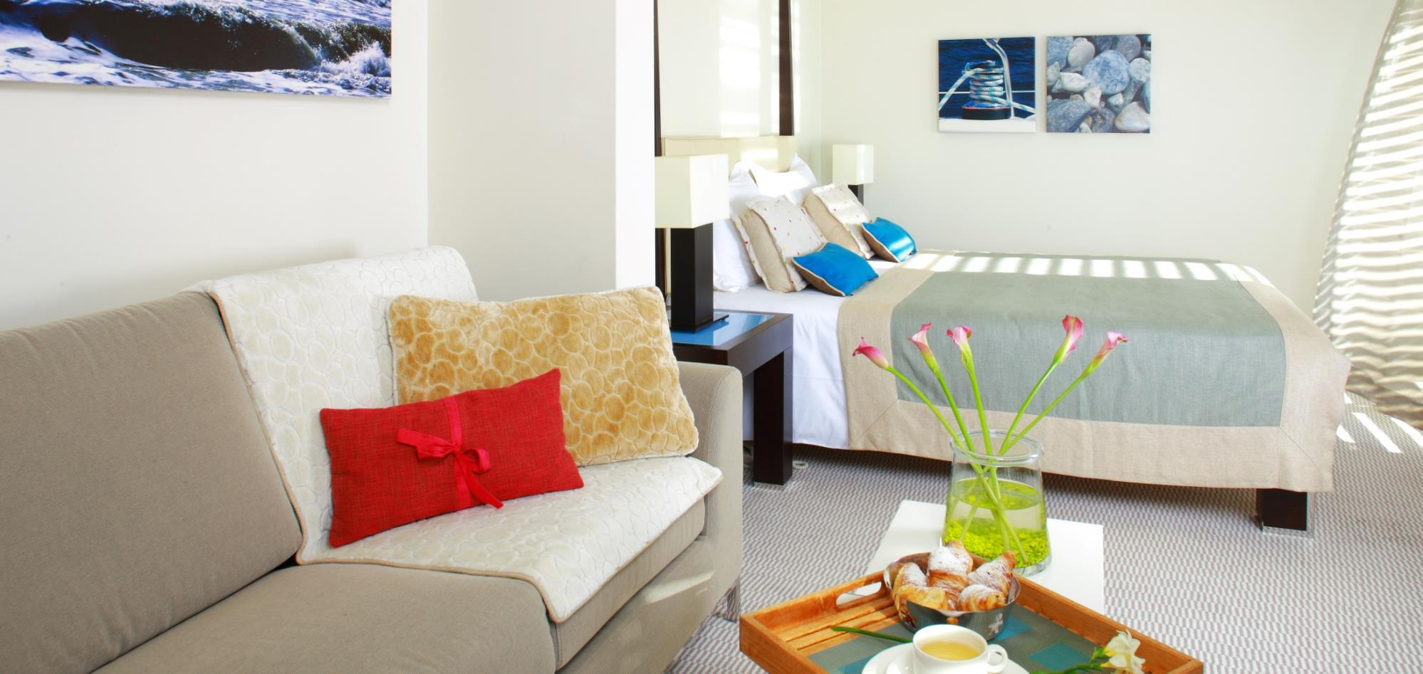
Hvar’s premier spa hotel with 1600 sqm of spa facilities, rooftop pool
Studio suite

Slide 56
Hvar’s premier spa hotel with 1600 sqm of spa facilities, rooftop pool
Superior accommodation

Slide 57
Hvar’s premier spa hotel with 1600 sqm of spa facilities, rooftop pool
Two large meeting rooms dividable into break outs

Slide 58
Meeting spaces are all with daylight

Slide 59
Panoramic terrace reception

Slide 60
Cascading pool party

Slide 62
200 rooms in pavillions, outdoor pool with bar, lobby bar & terrace

Slide 63
Pool with pool bar

Slide 64
Funky lobby bar

Slide 65
Pop art design

Slide 66
Unique event venues
OFFSITE MEETING FACILITES, HISTORICAL VENETIAN SETTINGS, BEACH FRONT VENUES

Slide 67
Beach Club Hvar is an event venue

Slide 68
Beach Club Hvar
Beach Club Hvar is an event venue

Slide 69
Exclusive dining at Loggia terrace

Slide 70
Exclusive events on Venetian terraces

Slide 71
Venetian loggia

Slide 72
Oldest communal theatre in Europe

Slide 73
The historical Arsenal building as a conference space
Seats 400 persons

Slide 74
The Arsenal as a dining venue

Slide 75
Thank you for your time and attention!

